Slide 1



Improvement of Patient Flow: Admission Delay
Notes:
Welcome and thank you for viewing my Presentation. I am Cassandra Barnard, the GHATP Fellow for Ralph H Johnson VA Medical Center located in Charleston, SC, VISN 7. My project for my GHATP Trainee year is “Improving Patient Flow: Admission Delay” 21

Slide 2
Project Goal and Objectives
Site Information
VISN 7: Ralph H Johnson VAMC in Charleston, SC
Complexity: 1A
Average Daily Admission Rate: 14.3
108 Acute Care Beds
The goal is to streamline the complex activities of the Emergency Department (ED) admissions process, by expediating shorter “Door to Floor” times by decreasing Admit Delay without impeding our focus of getting patients to the appropriate levels of care.
AIM: Decrease the FY20 median Admit Delay time of 128 minutes by 30% (a 90-minute target goal) by 3rd Quarter FY21.
Notes:
As Ralph H Johnson continues to strive to deliver consistently high-quality care, this project selection demonstrates our commitment to continuous process improvement, and exceptional customer service. The project AIM statement is to Decrease admit delay times by 30% or to a 90 minutes target goal, which will reduce admit ED to Ward LOS stay times, providing timely access to quality care, by 3rd Quarter FY 2021.

Slide 3
Patient Flow Measures
VSSC: EMMT Process Analysis Tool. EDIS National Report. RHJ .
Notes:
Our patient flow metric primarily focuses on Admit Delay. This metric is monitored via EDIS, Disposition triggers the start, when the Pt is removed from the EDIS board, the Admit Delay metric time ends. Our total time measure for this process is the admitted ED LOS, commonly referred to also as door to floor time. Our YTD metrics for FY20 were 128 for our median admit delay time.
We hold the best 1a facility rating of VISN 6 and 7 at 292 median ED LOS time, neither metric exceeded national thresholds. Competing at the national level is outstanding, and proves a focus on competitively delivering valuable services to our veterans, but we also looked at our Compare data for local private sector comparison/ add our compare data, which is added

Slide 4
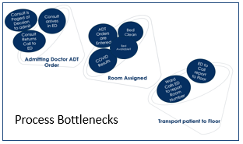
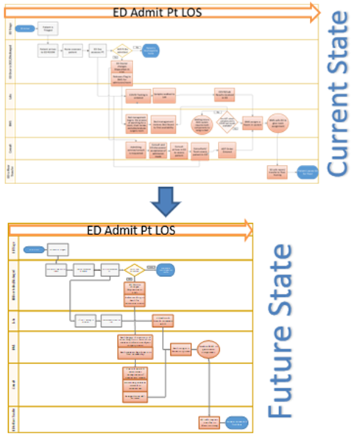
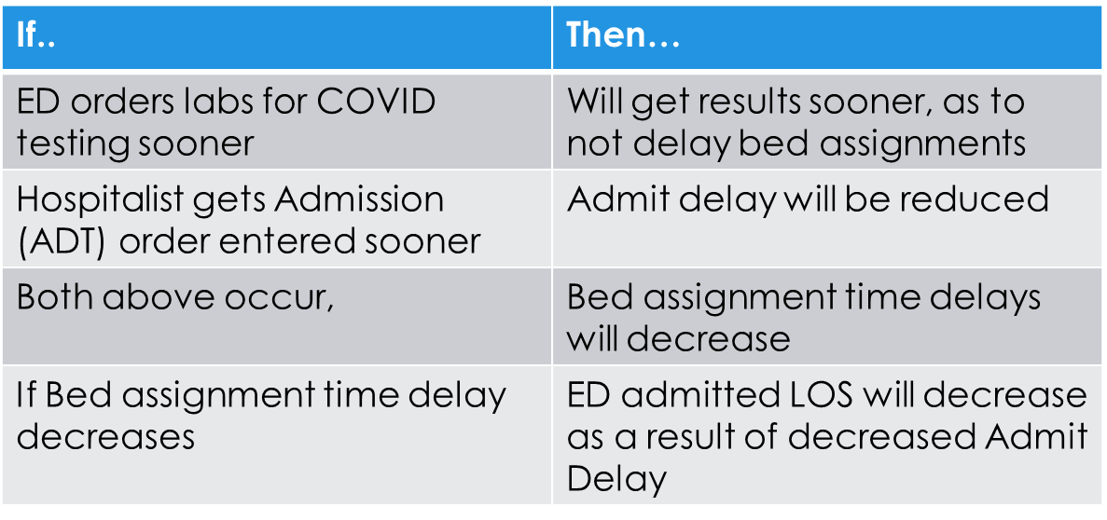
Closing the Gap
Notes:
To eliminate bottlenecks throughout the process, Alignment of the Decsion to admit Time with ADT Order and Bed assignment search is required. If Alignment occurs vertically in the future state, shaving time off the process is viable, in which we hypothesize, will decrease ED Admit PT los.
Process bottlenecks to the ADT order, which the ADT order was a bottleneck to Room Assignment

Slide 5
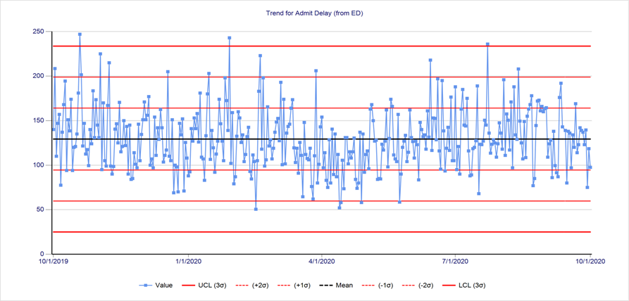
Current State Operational Barriers and Root Causes of Delays
40% of ED admissions occur after 5pm, when Bed management is not fully staffed.
COVID testing processes.
Bed Management communication delays.
When multiple consults or/and non general medicine consults are needed, admit delay times double, even triple.
Lack of System automation leads to inefficient communication.
Admit Delay times inherently contain both artificial variation and natural variation.
Bottleneck processes.
FY 20 Admit Delay. Daily Medians VSSC: EMMT Process Analysis Tool
Notes:
Through analyzing the data and weekly reporting, we discovered root causes demonstrating that admit delay time duration is not acuity specific. By analyzing and comparing data sources,, I identified outlier root causes and operational barriers. For example, when multiple consults were needed, our Admit delay times increased by 260% or more which was natural variation in the current state. Admit delay time errors in Assignment , which is a Data entry process affecting time stamping, however, caused artificial variation in our admit delay numbers.

Slide 6
Continuous Process Improvement Begins..
PDSA | Definition | Data Source | Target | Baseline Current State | Trial 1: Month 1 | Trial 2: Month 2
1 Executive Report outs | Establish recurring reporting of Patient Flow measures with granular level detail for ED admit delay | EMMT IFMT EDIS ED Data CPRS | Weekly Data Analysis Reporting Pass/Fail | None | Pass | Pass
2 Bridge Order Set | General medicine/hospitalist Created a CPRS order set: named MEDICINE ADMISSION ORDERS to decrease the amount of time to ADT Order | ED Data EDIS CPRS | Reduction of Time to ADT Order by 50% | 85 | 30 | 28
Notes:
Based on the Evulation of the process flow map, our first PDSA, was the requirement of weekly reporting to our PENTAD/Executive team. Weekly reporting leads to two important components of this project: Transparency and Accountability. And was pivotal in discovering the data trends. I utilized data from three sources: ED department tracking forms, Integrated Flow Management Tool (IFMT) : Integrated Admissions report and Improvement tools and the Emergency Medicine Management Tool- EMMT Process Analysis Tool reports to conduct audits and verify timestamps, we approached each service to request additional details regarding delays. and utilized pareto charting to determine root cause of delays. I analyzed Door to Doc, LWOBS and admit delay.
This drew attention to the timing of our ED COVID testing processes, which was later addressed by ED Leadership, by getting COVID Lab testing ordered sooner. This was a quick win/Just Do it/No PDSA needed
At the beginning of our measurements phase, the admitting physician time to enter The ADT Orders , accounted for roughly the first 56% of admit delay time metric.
The bridge order, sometimes referred to as a skeleton order, is a two-part order set, which allows immediate release of CPRS admit order at the time or close to the time the admitting physician agrees with ED Doctor to admit the patient. The second part of the order is done after face-to-face assessment of the patient occurs. This order set, was designed by the general medicine admitting team and was entered into CPRS as a new order set option.

Slide 7
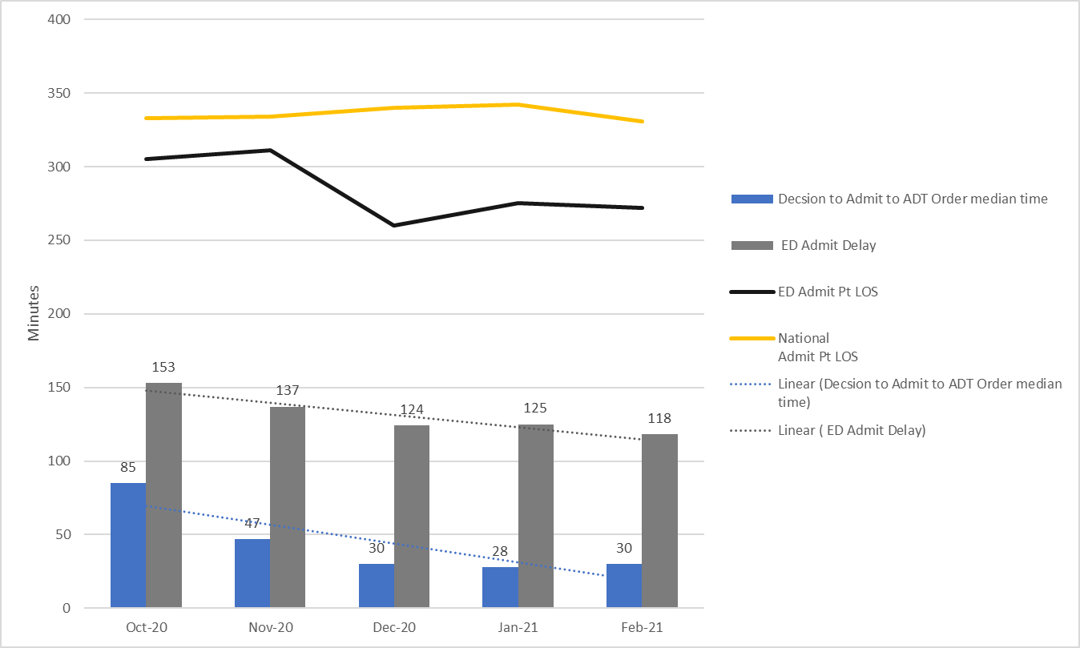
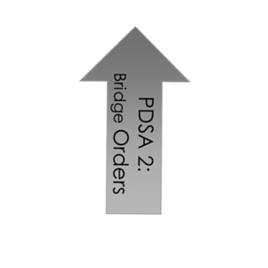
PDSA 2 Results
Monthly Medians
At the beginning of our measurement phase, Hospitalist time to enter ADT Orders from the Time ED Decsion to admit, contributed to about 56% of admit delay total time.
After the implementation of PDSA: Bridge Order, that has decreased to 25%
Admit Delay has decreased 22.8%
Notes:
The PDSA proved to decrease Admit Delay times and we seen a reduction in admit PT LOS. This is due to a vertical alignment of ED Decsion to admit with the ADT Order.
At the beginning of our measurement phase in October, the admitting physician time to enter ADT Orders , accounted for about 56% of the admit delay time measurement.
After the implementation of Bridge Order set in December, admitting physician time accounts for less than 26% of admit delay time.

Slide 8
Action Plan
Action Plan | Who | When | Progress | Outcomes
Taskforce: Analyze and Audit data sets. Determine measurable Process Performance item for vertical alignment to Decsion to admit (activities are parallel to Decsion to admit time stamp). | All Departments | FY2021 Q3 | In Progress
Create proper training, algorithms and SOP Guidance for Spread of Bridge order to other teams | All Departments | FY2021 Q3 | In Progress
Removal of bottlenecks: ED MD COVID test sooner ADT Order sooner to Dec to Admit Nurse to Nurse Communication (call to floor report process) | ED/Outpatient RN Team Hospitalist/Gen medicine Inpatient Nursing/ED/BMS | December 2020 December 2020 In Progress | Completed 95% 25% | Completed-Training executed Completed-Implemented In Progress
ED Doc to admitting Specialty ADT order time | ED and Admitting Specialties/ UM Committee | In Progress | 25% | In Progress
ED to Bed assignment- Checklist needed? BMS Report needed? BMS Metric establishment/spreadsheets | ED/Bed Central | In Progress- Delayed due to BMS System/big screen delays | 25% | In Progress
Notes:
This Project is on going; therefore, Costs have not been established as LOS is trends due to the pandemic, have been adjusted our acute LOS, due to
Application of visual controls, training aids and SOPs are needed such as communication check sheets, new order sets, CPRS modifications and sharing of information with all staff and service lines.

Slide 9
Lessons learned
.
Assign a Taskforce to ensure communication and continued efforts of facility and project goals are completed. Executive reporting ensures accountability and transparency.
Understood how differences in process inputs contribute to data systems outputs.
Ensure appropriate Data Capture and Data validation methods are occurring.
The Bridge order set is not Suitable for all ED admission patients but is a good start in shrinking admit delay times.
  Bridge order sets cannot reduce times if there is a lack of capacity.
    ED Crowding and fluctuation in the number of ED visits in comparison to admit delay times will dictate rather analyzing staffing models is needed.
  Targeted training for the Bridge Order process and a spread plan makes implementation successful.
Utilize both traditional tracking sheets as well as VSSC products such as the EMMT dashboard, the IFMT Improvement Dashboard and the IFMT Tools.
Analyze data from numerous data sources to understand overall effects of COVID Pandemic on LOS, Bed capacity, diversion, testing policies and ED protocols.
Notes:
Admit Delay metrics encompass a complex set of processes, and there is success in understanding the dynamics of all services involved in this process.
For total transparency, and to discuss findings of our project, we have assigned a taskforce which will be committed to finding, documenting and implementing best practices as we validate the future state of our admissions processes. Our Lessons learned involve understanding the constraints of the Bridge orders as a solution to Admit delay and also understanding factors that contribute to its success in reducing admit delay.

