Slide 1
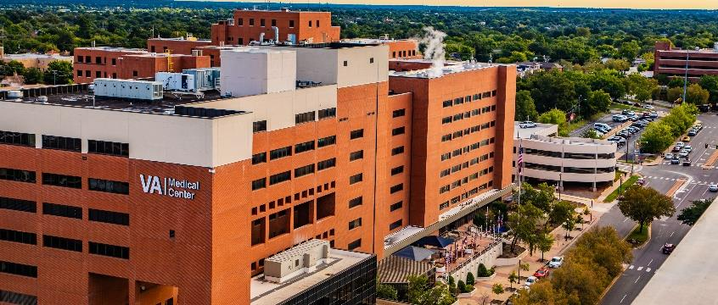
Expanding Specialty Care to Outpatient Clinics
Adrian Carter MHA, MLS
Oklahoma City VA Health Care System
VISN 19
Notes:
Recorded by Adrian Carter

Slide 2
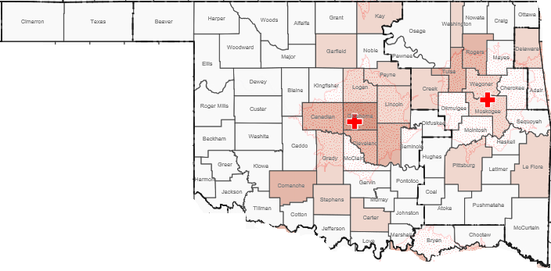
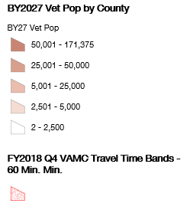
Background
Since the Mission Act was signed into law back in June 2018. The Oklahoma City VA has been actively working on increasing access throughout the rural areas of Oklahoma. Adding additional specialty care services will help reduce the number of Veterans we are sending out to the community.
Notes:
Mission Act- 60 minute drive time specialty or 28 days from the date of the request. 2018 a team came out to OKC and conducted an assessment on future growth of the Veteran Population in Oklahoma.

Slide 3
Goals/Objectives
To improve the veteran experience and decrease Community Care costs through;
Increased access in rural areas
Keeping veterans care within the VA System
Improved customer service due to less drive times
Notes:
Since the community care and facility budget for FY 22 are going to be combined; it is critical that we reduce the overall amount of Veterans we send into the community for care.

Slide 4
Plan of Action
Utilization of VVC and Telephone Clinics
Identify Locations and Specialty Needs
Utilize Different Space Routes
Develop Clinic Structure (grids, staffing, etc)
Activation of Clinic
Notes:
Steps to activate the clinic

Slide 5
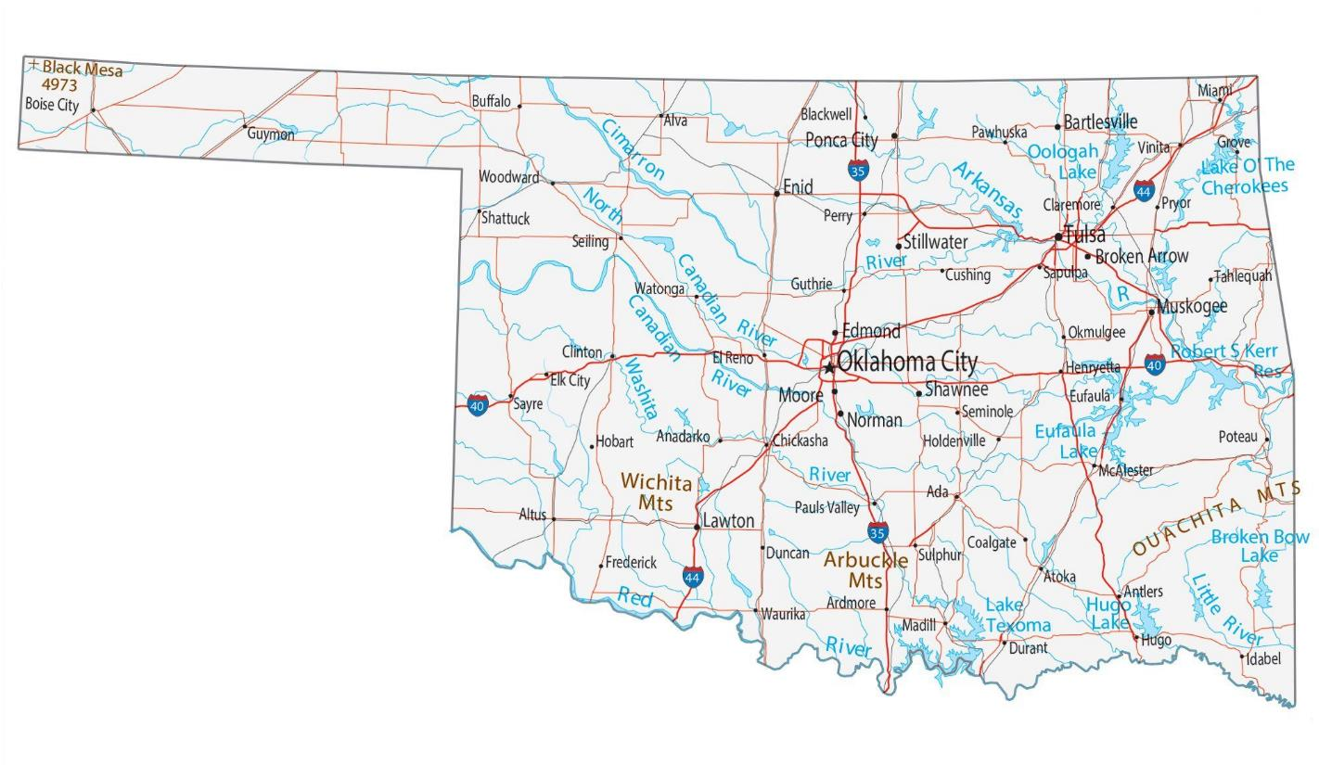
Locations
VA Staffed Clinics
Contract Clinics
Anticipated Clinics
Notes:
Majority of our specialty care clinics will be in our more populated veteran areas such as the Oklahoma City Metro, Lawton and Wichita Falls, Texas area.

Slide 6
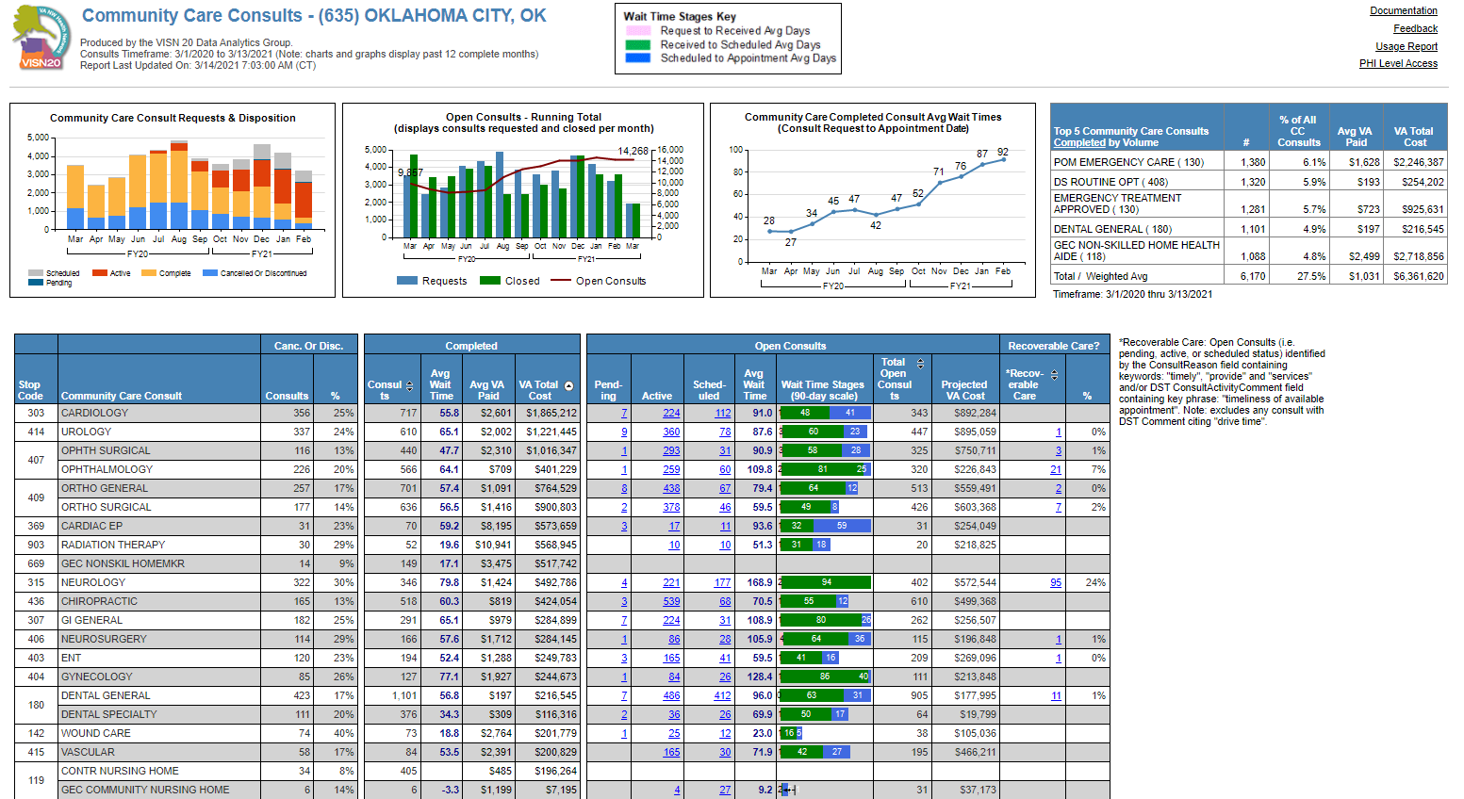
Community Care Data
Notes:
This data provided the frame work on which specialties we would like at each clinic.
Data pulled from - Reporting Services - Community Care - Station Summary (va.gov)

Slide 7
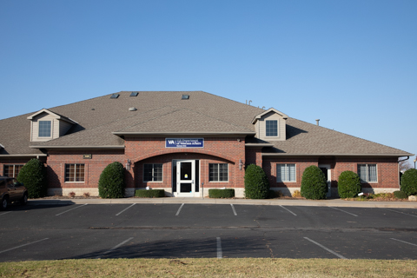
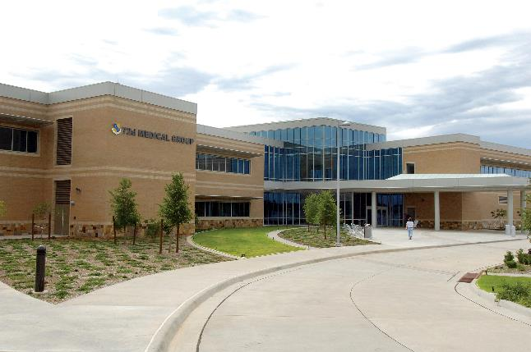
Methods
As Built
Norman
Yukon
New Leases
Clinton VA Clinic
Wichita Falls VA Clinic
MOU’s
Tinker Air Force Base
Ft. Sill Army Base
Redesign of Existing Space
HRO Project- North May Clinic
Notes:
As built- Purpose is to bridge care while larger clinics are being leased or built or to determine whether a permanent site is needed.
MOU- Lawton specialty clinic, Tinker (PT)
Redesign- North May adding access for MH and would clinic during covid surge

Slide 8
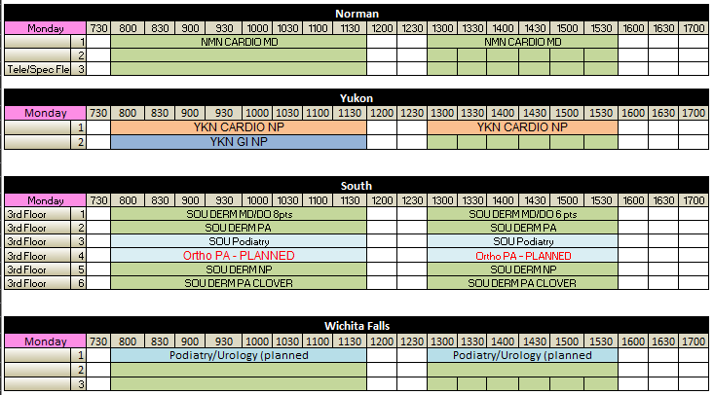
Clinic Grids
Notes:
Template on how the space has been organized. We have rotating clinics due to the many groups of specialty needed at the locations and not enough room. At this time Norman and Yukon are slowing bringing in their specialty providers.

Slide 9
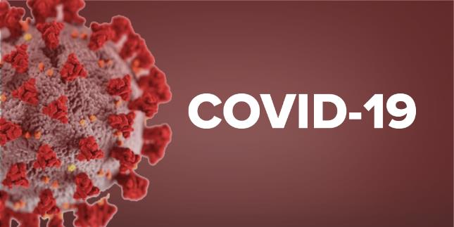
Barriers
Staffing
Difficult to hire providers/nurses in the more rural areas of Oklahoma
COVID
During the initial hit of COVID we had to reduce outpatient appointments to 25% to limit exposure and utilize staff in the inpatient units.
Notes:
Barriers we faced during implementation

