Slide 1
Automation of COVID-19 Data Entry
Lauren Feder, MPH
Graduate Healthcare Administration Training Program
2020-2021
Notes:
Hello, my name is Lauren Feder. I am participating in the Graduate Healthcare Administration Training Program through VISN 9 MidSouth Healthcare Network.
My project addresses some data entry challenges within the scope of COVID-19

Slide 2
Magnitude of Problem
United States:
29.25M+ total cases
455,000+ cases in the last 7 days
531,000+ deaths
Kentucky:
415,000+ total cases
5,000+ deaths
Tennessee:
789,000+ total cases
11,500+ deaths
Notes:
AS VISN oversees parts of Kentucky and Tennessee, it is relevant to know just how many US citizens have been affected by OCVID-19 in these states.

Slide 3
Background: COVID-19 in Veterans
Notes:
These graphs drill down to how the virus has affected our VISN 9 veterans.
The top graph shows how active COVID-19 cases have fluctuated in our veterans over the past year, and the bottom graph summarizes how this has contributed to total case trend over time.

Slide 4
Background: COVID-19 in Employees
Notes:
Like the veteran data the employee data Is thankfully starting finally to show signs of progress, with recovery starting to exceed newly contracted cases.
Even though this data is starting to show positive signs of improvement, the daily data entry requirements have not eased

Slide 5
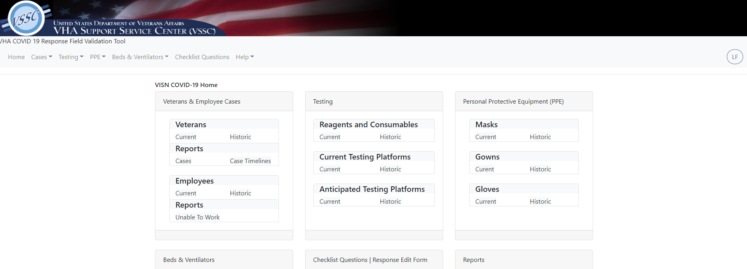
Current State: Daily Reporting Requirements
Notes:
This task involves hours of compilation for each facility’s point or points of contact
They have to pull data from national data warehouses, analyze and clean it, and put it into context of overall COVID-19 trends
Facility responsibilities have only grown, as they juggle the duties of normal positions, duties required by COVID-19 infection data entry, and newer duties involving vaccine rollout and tracking
Though facility points of contact have managed these responsibilities, it has not been without complaint or stress
Many have asked if there are any reporting requirements that could be deemed unnecessary, or if there is a quicker way to compile the data

Slide 6
Goals
Automation
- Ease of use
Time Management
Expansion of Responsibilities
- Increase efficiency - Increase independence
- Evolving facility, VISN, and national reporting needs
Documentation
- Need exhibited in multiple regions
- Applicability to future challenges
- Increase accuracy
- Trainability
- Increase consistency
Exportability
Notes:
That is where this project comes in
Ideally, I would like to work with the facilities to automate the front-end data collection
This would look like pulling the data from national sources to populate a report that could then be input into the VSSC tool, otherwise known as the VHA Support Service Center’s COVID-19 Response Field Validation Tool.
This would increase ease of use, and once this process exists, it would be standardized and this easier to train new points of contact on
This would make the daily reporting process easier, more efficient, more consistent, and accurate, freeing up time for the points of contact to conduct other duties.
Even after COVID-19 is in the rearview window, this will still be relevant because it will hopefully showcase how to better track data should another disaster of this magnitude arise
In the meantime, we know this is not a project or problem specific to VISN 9, so it will be applicable to other VISNs as well

Slide 7
Multi-Level Impacts
Notes:
Speaking of other VISNS, I have consulted multiple networks and individual facilities regarding their process for pulling, summarizing, and inputting the COVID-19 data.
While all parties use the same national databases to pull the data, the practices vary on who pulls it, who dedicates time to analyzing and validating it, and who inputs it into tools like the VSSC Tool
Establishing a best practice would free up personnel time at the facility level, standardize reporting at the VISN level, and provide more accurate, timely information for Central office at the national level

Slide 8
Actions Taken
Open communication channels
Stakeholders:
Data analysts
Facility compilers
VISN personnel
VACO
Continuing education
Pilot project – automated PUI data pull (persons under investigation)
Notes:
Reaching out to other networks and facilities for guidance is one of the action steps we have taken in the process of implementing this project
Another was instituting a pilot project for automation of PUI data, the most time-consuming portion of the data collection process according to facility points of contact.
We are continuing to work and collaborate with these stakeholders and it’s an ongoing process

Slide 9
Thank You
Lauren Feder, MPH
Health System Specialist/GHATP Trainee
VISN 9 MidSouth Healthcare Network
Office: (615) 867-6000 ext. 67243
Cell: (803) 586-2911
Email: Lauren.Feder@va.gov
Notes:
But for now, I’d like to thank you for your time and attention and here is my contact information should you need it.

