Slide 1
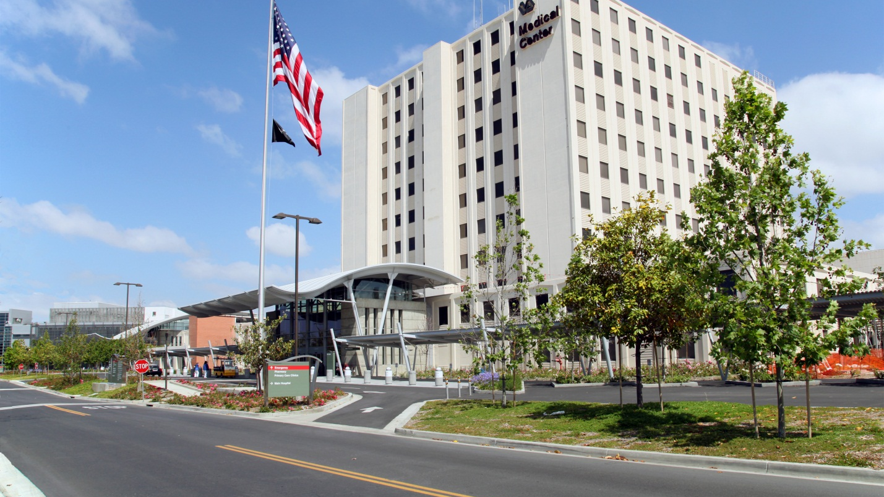
Ernest Fiyufe: GHATP Fellow VALBHS-Station 600, VISN 22.
Systematic Improvements Using Lean Knowledge Understanding & Practice.
The Quest to Become the Best Healthcare System in the Nation
Notes:
Hello everyone. My name is Ernest Fiyufe and I am the GHATP Fellow for VALBHS. My presentation is about Systematic Improvements Using Lean Knowledge Understanding and practice.

Slide 2
Background & Description
VALBHS is undergoing a Lean transformation to drive improvement in the care and services delivered to Veterans.
What is Lean?
A continuous process improvement approach that identifies and eliminates waste to maximize resources and improve performance.
3400 Employees at Medical Center and 6 CBOCs
Notes:
Currently, VALB is undergoing a Lean transformation to drive improvement in the care and services delivered to Veterans.

Slide 3
Challenge
There is slow infusion of lean practice across the healthcare system.
Aim
To infuse a Lean culture by exciting, engaging and developing staff’s ability to use Lean tools.
Notes:
However, the challenge with our implementation is that there is slow infusion of lean practice across the medical center and with this project, we plan to excite, engage and develop employee’s ability to use lean tools.

Slide 4
Employee Experience in Lean
Current | Target State (70% Increase)
589 | 1001
Notes:
Current data from systems redesign shows that only 589 employees here in LB are fully confident and competent in Lean. We want to increase that number by 70% by the end of the calendar year 2021.

Slide 5
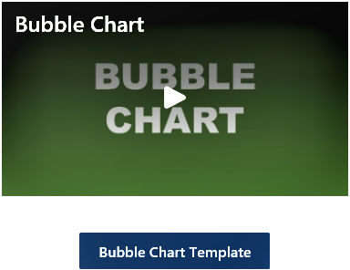
Planning and Development
Create Videos of Lean Tools
Redesign and Launch Lean Transformation Site with Videos
Create and Launch Improvement Competition
Increase
-Excitement
-Lean Learning
-Process Improvements
Market to Employees
Promote CPI Fair in DMS huddles
Publicize Lean Transformation site.
Notes:
In terms of planning and development, we created videos of lean tools for the facility, redesigned our lean transformation site to make it easy for employees to access and use these videos in their lean learning and application. To further encourage participation and learning, we created and lunched a continuous process improvement fair, a quarterly event that publicize and showcase successful process improvement efforts.

Slide 6
Resources Required
Motivated and dedicated team of experts in video creation
knowledgeable Lean script writers
Video animation experts
SharePoint redesign professional
Video editing and filming crew etc.
Executive Leadership Team (ELT) buy-in and Support
Active ELT involvement & Participation is needed
ELT must provide support to encourage Lean Learning/Practice
System Redesign Staff and process coordinator etc.
System Redesign provide script, content and context for Lean Tools
Process Coordinator Coordinates and lead the process
Notes:
In terms of resources, we had a motivated team of experts in video creation that came together and created Lean Tools videos for the facility. Our executive leadership team was on board and continue to be proactive in supporting this initiative.

Slide 7
Implementation Within Our Lean Framework
Train Leaders in Lean:
Principles
Continuous Improvement
Respect for People
Methods
Deploy the Lean Management System
DMS
Value Streams etc.
Create a culture of employee empowerment
Tools
Standard Work
RIE
A3, 5S etc.
Recognize and Reward
Employees
Workgroups
Notes:
To be successful with our implementation, we must train Healthcare Leaders in lean principles. That is the principles of continuous process improvement and respect for people. We must train our leaders in lean methods by deploying a lean management system and building a culture of employee empowerment that enables the removal of barriers and frustration. We must train our employees on lean tools so that they can use that knowledge to improve processes. Here at VALB, we have created a system that recognizes and rewards employees and workgroups for proper use of Lean Tools.

Slide 8
Benefits and Cost Impact
Increase Lean knowledge understanding and practice
Consistent micro enhancements in operations
No extra FTE
Able to use current available resources
Anticipate significant cost savings and efficiencies
Small gains
Transformational gains
Notes:
This project has great benefits. It will help us Increase Lean knowledge understanding and practice. We will see Consistent micro enhancements in operations. We did not hire extra FTE for this project. We only reallocated our human and technology resources to create and implement this project.

Slide 9
Relative Scope of Project
Facility-wide
Potential application in other facilities at the VA
Project can also be applied VA wide
Notes:
This implementation can work in other facilities and across the VA.

