Slide 1
Improving Implant Inventory Management
A Lean Project
Description and Background
Implant procedures are an important service offered at VA San Diego
Implant procedures are provided by various services, including dental, endovascular, and urology
Implants help veterans meet their full physical and socioemotional potential
Problem Statement: The implant inventory process at VASD has not been efficiently managed to purchase, receive, and inventory biological and non-biological implants. Mismanagement is causing excess inventory, expired inventory, excess costs, and inadequate supply for planned and unplanned surgeries and procedures.
Notes:
Hello. My name is Nicolas Girard and today I will be presenting the results of a lean project on improving implant inventory management. This topic was chosen because implant procedures are an important service offered at VA San Diego and can help veterans meet their full physical and socioemotional potential. However, our implant inventory process at has not been efficiently managed to purchase, receive, and inventory biological and non-biological implants. Mismanagement is causing excess inventory, expired inventory, excess costs, and inadequate supply for planned and unplanned surgeries and procedures.

Slide 2
Goals and Objectives
Executive Sponsor:
Associate Director
Process Owners:
Inventory Management Specialist
Implant Coordinator
Associate Nurse Executive, PeriOp
Chief of Prosthetics
Management Supply Specialist
Cardiac CathLab Supervisor
Facilitators
Health Systems Specialist, Systems Redesign
Health Systems Specialist, Office of the Director
Improve the Veteran’s experience of care
Reduce number and/or value of expired implants by 15% during pilot period
Reduce staff time spent managing implant inventory
Increase use of scanners and InVita-UDI tracking system
Improve communication between key process owners and stakeholders
Explore consignment opportunities to avoid expiration problem entirely
Notes:
Our number one goal, in alignment with the ICARE model, is to improve the Veteran’s experience of care. During the pilot period, we primarily hoped to reduce the number and/or value of expired implants by 15%.

Slide 3
Baseline Data December 2019 – October 2020
Pre-RPIW Total: 249 Items
23/month
Pre-RPIW Total: $224,442
$20,404/month
Notes:
Before the rapid process improvement workshop, we were experiencing an average of 23 implant expirations per month at a cost of $20,404 divided among various sections.

Slide 4
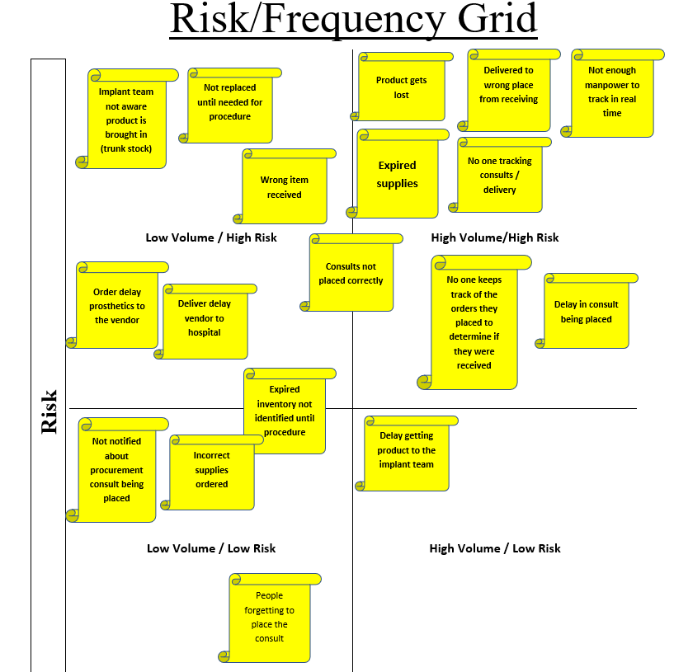
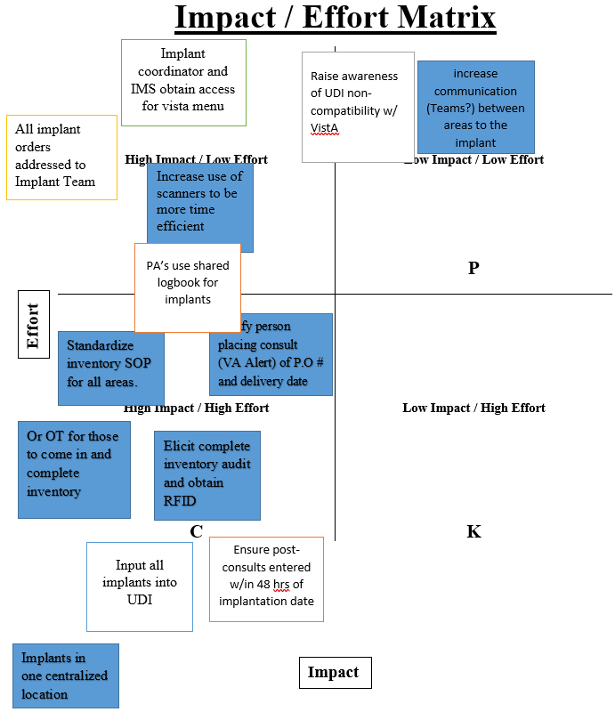
Implementation
Notes:
This project began with a 3-day rapid process improvement workshop which followed the standard Define-Measure-Analyze-Improve-Control or DMAIC model. This included the creation of current and future state maps with identification of pain points, development of impact/effort and ease/effectiveness matrices and performing a gap and root cause analysis to determine action plans.

Slide 5
Implementation, cont’d Gap and Route Cause Analysis (5 Whys)
Gap
Lost product
Expired inventory
Incorrect delivery location
No real-time tracking
Consult placement delays
Lack of coordination
Root Cause
Item not tracked after ordering
Hospital-wide inventory not up-to-date
Incorrect delivery information
Centralized tracking system not used
Insufficient/inefficient staff resources
Process owners not sharing information
Action Plan
Creation of shared tracking database
Inventory stand-down initiative
Centralize delivery location
Increase use of inventory scanners
Protected time for consult placement
Sharing of VistA menus and other resources
Notes:
Several gaps were identified, including lost product, expired inventory, and incorrect delivery location. Addressing these gaps resulted in the creation of a shared tracking database, beginning an inventory stand down initiative, and centralizing the delivery location for implant purchase orders.

Slide 6
Post-Initiative Data November 2020 – January 2021
Count of Expired Items/Month
Cost of Expired Items/Month
Department | Pre-RPIW | Post-RPIW
Arthroscopy | 1.45 | 0.00
Cardiothoracic | 0.27 | 0.00
Dental | 1.91 | 3.00
Dermatology | 0.00 | 0.33
Endovascular | 6.73 | 16.67
ENT | 0.82 | 0.00
General | 1.36 | 1.00
Head/Neck | 0.45 | 2.00
IR | 0.00 | 0.67
Neurology | 0.82 | 0.00
Opthamology | 3.00 | 9.33
Podiatry | 1.91 | 1.67
Urology | 2.09 | 0.00
Vascular | 0.27 | 0.00
Wound | 1.55 | 2.67
Department | Pre-RPIW | Post-RPIW
Arthroscopy | $719.99 | $0.00
Cardiothoracic | $157.82 | $0.00
Dental | $195.73 | $400.71
Dermatology | $0.00 | $225.67
Endovascular | $10,960.34 | $33,063.71
ENT | $428.75 | $0.00
General | $1,820.42 | $6,945.38
Head/Neck | $168.40 | $1,258.07
IR | $0.00 | $824.74
Neurology | $688.56 | $0.00
Opthamology | $184.72 | $3,337.48
Podiatry | $2,206.84 | $3,509.68
Urology | $1,338.75 | $0.00
Vascular | $345.45 | $0.00
Wound | $1,188.08 | $559.33
Pre- RPIW Total: 249 Items
23/month
Post-RPIW Total: 112 Items
37/month
Pre-RPIW Total: $224,442
$20,404/month
Post-RPIW Total: $150,374
$50,124/month
Notes:
This slide shows the post-RPIW data for the three months following implementation of the pilot. On average, we did not see the improvements that we had hoped for. This is primarily because excess ordering from the past fiscal year is just beginning to reach expiration, especially for some of the higher-cost endovascular items. However, notable improvements did occur in individual sections. Eight sections showed a decrease in expired items per month, with six of those decreasing to zero. Similarly, seven sections showed a decrease in cost of expirations, with six of those decreasing to zero. The sections with improvements are highlighted in green.

Slide 7
Outcomes and Cost Savings
Improved communication and data visibility between process owners
Greater accountability and transparency through use of shared tracking spreadsheet
Decreased number of improperly delivered orders
Consults being placed in more timely manner
New sub-initiative focused on exploring transition to consignment-based inventory
8 departments with decrease in expired inventory count, 7 with decrease in expired inventory cost
Equivalent savings of 19 items and $12,921 in 3-month time period.
5-Year ROI: 380 items/$260,000
Notes:
As a result of this initiative, we have seen improved communication and data visibility between process owners, a decrease in the number of improperly delivered orders, and an increase in the timeliness of consult placement. Financially, the decrease in expired items in certain sections equates to a 5-year return on investment of 380 items and $260,000 saved.

Slide 8
Benefits and Recommendations
Improving implant inventory management has both direct and indirect benefits for the safety and care experience of Veterans
Directly, it decreases the risk of surgical delays and cancellations due to expired/inadequate implant stock
VSignals and PATS-R shows this is one of Veterans’ top complaints
Indirectly, cost savings can be used to hire additional staff or improve facilities and equipment
It is recommended that any facility dealing with large quantities of costly implant inventory perform regular expiration audits
Excess expirations may warrant the formation of a workgroup
Endovascular may be particularly worthwhile to focus on due to the high cost of their implants
Notes:
Delivering the best possible experience of care is the driving mission behind our performance improvement activities at VA San Diego. Improving implant inventory management has both direct and indirect benefits for the Veteran. Directly, it decreases the risk of surgical delays or cancellations due to expired or inadequate implant stock. Indirectly, cost savings can be used to hire additional staff or improve facilities and equipment.

Slide 9
Application Potential in Other Facilities
Implant expiration is an issue faced by many VA medical centers
Several of the specific improvements discussed in this project could be easily implemented at other facilities with similar root causes
For facilities facing unique challenges to their implant inventory management, this project demonstrates that a DMAIC-focused RPIW with weekly follow-up meetings is an effective tool for problem-solving
Thank You! Please feel free to contact me with any questions or comments.
Nicolas F. Girard, MPH
Health Systems Specialist (GHATP Trainee)
VA San Diego Healthcare System
nicolas.girard@va.gov
Desk: 858-642-3989 - Mobile:619-964-4798
Notes:
Implant expiration is an issue faced by many VA medical centers. Several of the specific improvements discussed in this project could easily be implemented at other facilities with similar root causes, and this project demonstrates that a DMAIC-focused RPIW with weekly follow-up meetings is an effective tool for problem-solving.
Thank you for taking the time to view this presentation. Please feel free to contact me with any questions or comments.

