Slide 1
FEASIBILITY STUDY FOR ORTHOTIST/PROSTHETIST PLACEMENT WITHIN ROBLEY REX VA MEDICAL CENTER’S COMMUNITY BASED OUTPATIENT CLINICS
Feasibility Study For Orthotist/Prosthetist Placement At Robley Rex VAMC Community Based Outpatient Clinics
Charles R. Hantz Jr., M.B.A., GHATP Trainee
Louisville, Kentucky MidSouth Healthcare System VISN 9

Slide 2
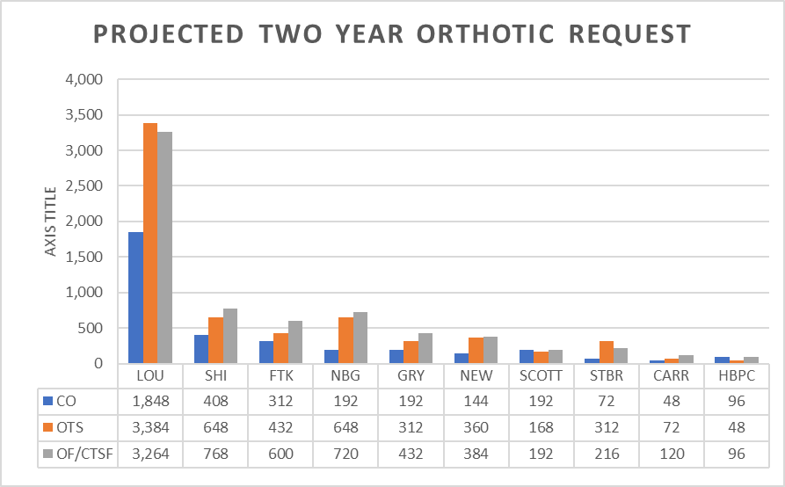
CURRENT STATE
RRVAMC Prosthetics Department is full-service w/on-site fabrication laboratory.
Currently issues, fits, and fabricates all orthoses at main campus.
Stocking and issuing all off-the-shelf (OTS) items.
Orthotic requests are load bearing on the Certified Orthotist (CO) due to issuing OTS items. See (Fig. 1).
NPPDB
Fig. 1

Slide 3
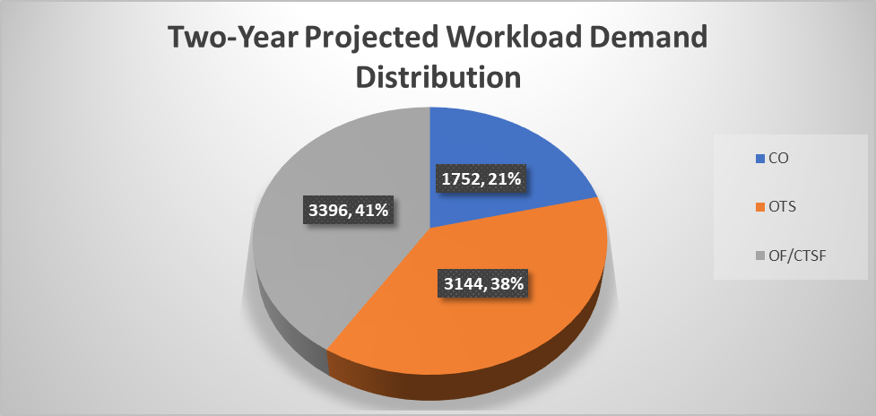
PAIN POINT
Certified Orthotist (CO) licensure capacity is not being utilized efficiently.
Realization of a combined 79% of CO appointments are for OTS and Certified Fitter-orthotics/Certified Fitter-therapeutic shoes (CFo/CFts) items (Fig. 2).
Increased wait time for custom orthotic appointments.
Fig. 2

Slide 4
GAP ANALYSIS
No Certified Fitter-orthotics(CFo)/Certified Fitter- therapeutic shoes (CFts)
Non-point of issuance for OTS items by PACT Team members
Dormant Vendtek Cabinets not being utilized
Studying space requirements/availability, on-site laboratory needs, it does not appear feasible to place Certified Orthotist (CO) at the CBOC’s.

Slide 5
POSSIBLE FUTURE STATE
Implement point of care issuance for OTS items by utilizing dormant Vendtek cabinets.
Capture inventory needs via Point of Use (POU) equipment.
Vendtek cabinets to be linked (interfaced) with the VHA-approved inventory system that allows all required data to be captured which aligns with (VHA Directive 1761(2) Appendix K.
Hire Certified Fitter-orthotics (CFo)/Certified Fitter/Therapeutic Shoes (CFts) for adjusted prefabricated issuance.

Slide 6
CONCLUSION
The more feasible option is to allow PACT team Members (Nurse/Practitioner) to issue OTS items.
The point of care issuance is covered by Deputy Under Secretary for Health Operations Memorandum dated February 16, 2018 as well as guidance from The American Board for Certification Orthotics/Prosthetics/Pedorthics.
If implemented, Veteran/facility will gain reduced wait times for custom orthotic appointments.
Reduction in projected travel pay costs of $238,060.
Value added streamlined service for the Veteran.

Slide 7
TRANSFERABILITY
This process may transfer to other VAMC’s or their respective CBOC’s
Directives already in place for point of care issuance
Increased efficiency
Minimal training on Vendtek Cabinets
Veteran Centric

Slide 8
CONTACT INFORMATION
Charles R. Hantz Jr., M.B.A.
charles.hantzjr@va.gov
Cell-228-209-3306

