Slide 1


Pharmacy Only Uniques Improved Patient Safety, Workload Capture, and Funding
North Florida/South Georgia Veterans Health System
(NF/SGVHS)
Masciel Irizarry, MBA
GHATP Trainee
ACHE Congress – March 2021
Notes:
My name is Masciel Irizarry, and I will be presenting my GHATP ACHE project on improving Patient Safety, Workload Capture, and Funding of Pharmacy Only uniques.

Slide 2
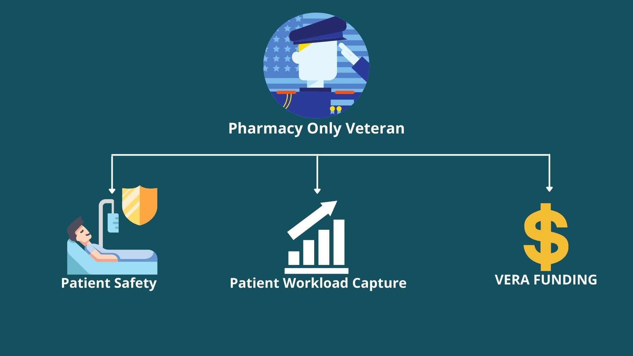
Problem Statement
Project Goal:
To establish an in-house evaluation protocol for pharmacy only uniques in order to improve medication safety and increase eligible VERA workload and funding.
Notes:
A gap in the ability to efficiently monitor patients who are under pharmacy only status within VHA has been identified. Currently, pharmacy only uniques do not receive any other VA care and do not follow up with a VA provider for evaluation and monitoring of medications. This can lead to significant issues. First is patient safety. A National VA requirement states that Veterans must complete a primary care examination by a VA provider at least once a year, even if they receive outside care.
The second issue is capturing patient workload. Factors such as COVID can reduce workload and Veteran unique numbers. It is vital we continue to follow-up with Veterans in our care, which increases Veteran uniques and decreases Pharmacy Only uniques.
Lastly, a missed opportunity to receive VERA funding. VERA funding can be used to build and update clinics structurally and provide staff with the latest technology and equipment to care for our Veterans. Establishing an in-house evaluation protocol for pharmacy only uniques would improve medication safety and increase eligible VERA workload and funding.

Slide 3




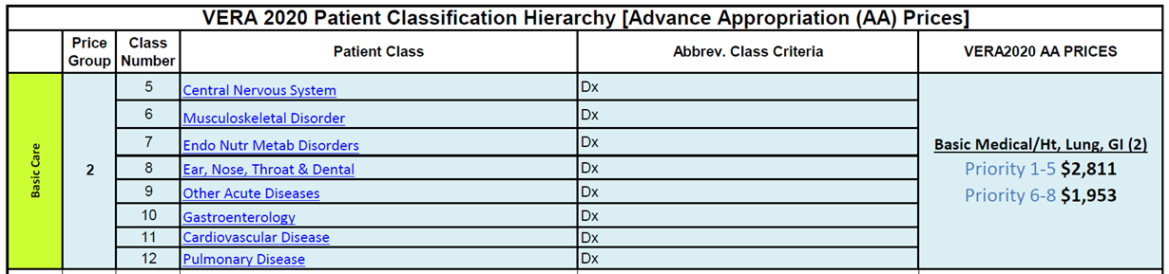
FY2020 Pharmacy Only Uniques Data
1,285 Pharmacy-Only Veterans in VERA price group 1 = $0
If these Veterans had been seen by a VA primary care provider, they would qualify for price group 2, priority 1-5 = $2,811
NF/SGVHS missed the opportunity to receive $3,612, 135 in VERA funding (1,285 x $2,811)
Notes:
In fiscal year 2020, the North Florida/South Georgia Veterans Health System (NF/SGVHS) had 1,285 Pharmacy Only uniques. We missed the opportunity to receive VERA funding. According to the Veterans Equitable Resource Allocation (or VERA) model, the Pharmacy only unique patient class is not funded. If each unique had a clinical encounter at our health system, they would have been safely monitored and classified in price group 2. This price group change would have generated at least $2,811, totaling over $3.6M.

Slide 4

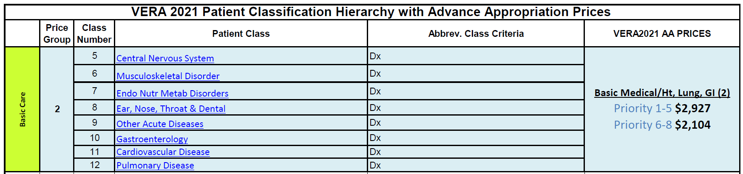
FY2021 Potential VERA Funding
320 Pharmacy-Only Veterans in VERA price group 1 = $0
Appointment = price group 2, priority 1-5 = $2,927
Opportunity to receive $936,640 in VERA funding (320 x $2,927)
Notes:
To maximize potential, we focused our efforts on pharmacy only uniques in FY2021. The VERA Coordinator ran a pharmacy only report from the Allocation Resource Center (or ARC) website. We identified 320 Pharmacy Only uniques that had not been seen by a VA provider in over a year. Moving this group of Veterans to price group 2 could result in generating $936,640 in VERA funding.

Slide 5


Pharmacy Only Letter
Veterans will receive a personalized letter in the mail.
Notes:
We implemented a Pharmacy Only Mass Mail Out process. Personalized letters were mailed out to the 320 Pharmacy Only Veterans earlier this year. The letter reminded them the importance of their health, the National VA requirement that could affect their ability to receive VA medications, and how to schedule an appointment to be seen virtually or face-to-face.

Slide 6












Results
(114 x $2,927) $333,678 in VERA funding
114 Veterans (36%) have either been seen or have future appointments
VERA funding could be increased from zero to at least $2,927 per unique
Veteran medications are safely monitored
Notes:
Initial results to date show 114 of 320 Veterans have either been seen or have future evaluations. This enhances our ability to safely monitor our patients’ medications, accurately capture workload, and generate a minimum of $333,678 in VERA funding.

Slide 7


Recommendations
Contact Pharmacy Only Uniques Bi-Monthly
Opportunity for Veterans to Choose VA
VERA funding supports salaries, administrative and clinical efforts, and equipment
Enhances Veteran and Employee experience
Notes:
It is recommended to contact Pharmacy Only uniques bi-monthly. This gives us an opportunity to get them familiar with VA services, back into care, and increases our Veteran unique count. This aggressive approach could provide the financial support for salaries, administrative and clinical efforts, and equipment. These resources will ultimately improve the Veterans and Employee Experience.

