Slide 1
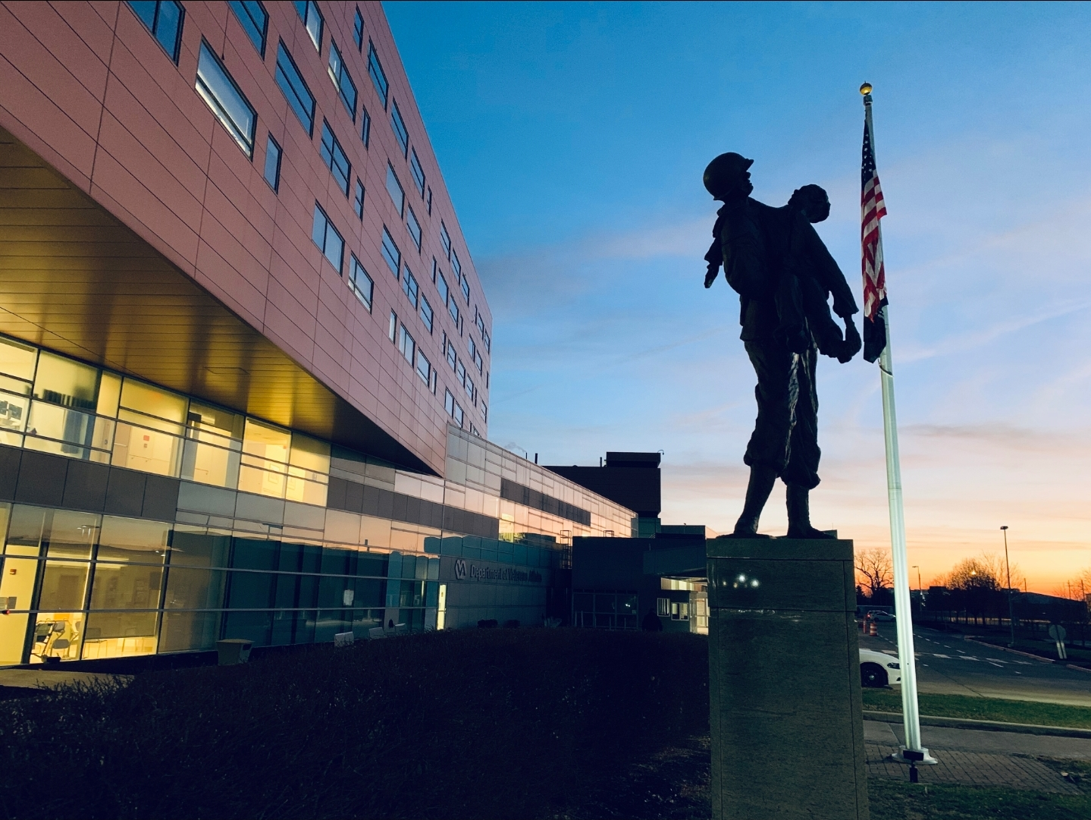
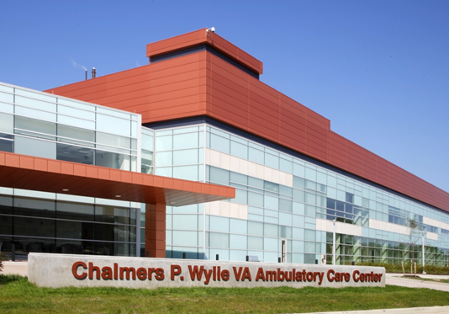
Community Care Billing Optimization
James Lee, MHA (GHATP)
VA Central Ohio Health Care System/Chillicothe VA Medical Center
DATE: 03/22/2021
Notes:
Hello, My name is James Lee, GHATP for Columbus VA along with Chillicothe VAMC. I am here to present my ACHE project, which is on Community Care billing optimization.

Slide 2
Project Background
Background: VA Central Ohio Health Care System has significantly improved and earned Veterans overall Trust to over 90%. However, Community Care Billing issue has continuously been constant top concern for our Veterans.
Problem: Community Care department unable to allocate staff to assist/resolve Veterans community care billing issue due to increase in consults/referrals to the community due to COVID-19. Non-standardized process/procedure in the community care department on handling the billing inquiries from the Veterans, Authorization/referral inquiries from the Community Care providers. Long wait time (Average of 40+Minutes) at Community Care Contact Center (C4) increasing Veterans’ dissatisfaction.
Notes:
Columbus VA has continuously improved and earned Veterans trust to over 90%. However, Community Care billing is still a top concern for all the Veterans. Our Community Care Department was not equipped with adequate staff to assist Veterans with these billing issues and relied heavily on Community Care Contact Center and Patient Advocates to assist with these issues.

Slide 3
Goals and Objectives
Establish contact with top 5 Community Care Providers and host monthly calls to discuss on-going billing issues on both sides. Promote and enroll providers to HSRM so they could lookup and retrieve VA Authorizations (Billing department & Clinical Referral Representatives).
Create centralized area within VAMC in which teams from following departments will be occupying: CPAC (VA Billing), Community Care Billing, Referral Coordination Initiative (RCI), Patient Advocate, and Veteran Experience team.
Increase Veterans Satisfaction with VA by providing assistance with billing issues along with Referral coordination.
Notes:
Goals and objective of this project was to establish contact with top 5 community care providers that services 90% of our Veterans and establish a good working relationship along with hosting monthly calls between community care billing department and Columbus VA. Also, to create a centralized area within VAMC acting as one stop shop for Veterans with Community Care billing concerns

Slide 4
Project Benefit
Establish working relationship with the Community Care Providers to resolve Veterans’ billing issue along with working together to increase Veterans’ satisfaction with care in the community. Automate consult/referral process by promoting and enrolling community care providers to HSRM (Health Share Referral Manager) and provide them with instant resources need for billing along with referrals (accept/deny, upload medical records, set appointments and etc). Enrollment in HSRM by Top 5 providers will benefit ALL VAMC within State of Ohio.
Provide one stop shop resources for Veterans to resolve any issues related to Community Care Billing
Closer collaboration with Community Care Providers and VA Third Party Administrator (Optum) to work more closely together.
Notes:
Greatest benefit of this project is to provide peace of mind to the Veterans regarding their care in the community by preventing unnecessary bills from going to the Veterans. Also, we will be able to build relationship and trust with the community care providers so that they will provide exceptional services to our Veterans.

Slide 5
Actions
Monthly/Quarterly calls between VA and CC Providers (Billing, Clinics, Case Management) to review process along with issues they might be facing providing care for our Veterans.
Provide HSRM resources to Community Care Providers (Billing, Clinics) such as HSRM training registration information along with manuals/guidebook to reference.
Created 1-Stop Shop within Columbus VAMC staffed with Billing resolution specialist, CPAC (for VA Bills/Co-Pays), RCI (Referral Coordination Initiative), HSS (Vendor support).
Conduct continuous education for Veterans on the Community Care consult/referral process
Continuous outreach to Community Care Providers and their Billing+Referral Centers on enrolling in HSRM.
Notes:
Actions taken on this project are:
On-going Monthly calls with the Community Care Providers, Third Party Administrator-Claims department
One stop shop within Columbus VA
On-going education for the Community Care Providers
Education to the Veterans regarding Community Care process

Slide 6
Progress
Created space within VAMC for Billing/Referral support. One stop shop for Veterans with VA Billing issue (Co-Pays), Community Care Referral/Consults, Community Care Billing issue. Going live on Monday (3/15/21) as part time (M, W, Fri) until all offices (CPAC, CC RN/LPN, RCI) are set-up. Billing Specialist (MSA) will be assisting Veteran walk-ins regarding Billing issues.
Established Monthly call schedule with Community Care Provider billing departments and VA to review and discuss Billing/Authorization verification. Quarterly calls with CC Billing, Clinics, Case Management, Referral Center is scheduled for the future.
4 out of 5 Community Care Provider billing departments enrolled and utilizing HSRM for Authorization verification with Clinic team to follow.
Notes:
One stop shop is scheduled to go live on Monday, March 15th, staffed with appropriate personnel.
Also, we are expanding monthly calls to include Community Care Clinic Leadership team, Case Management team, Social workers
Lastly, 4 out of 5 Community Care provider billing departments are fully utilizing HSRM to look up Authorizations.

Slide 7
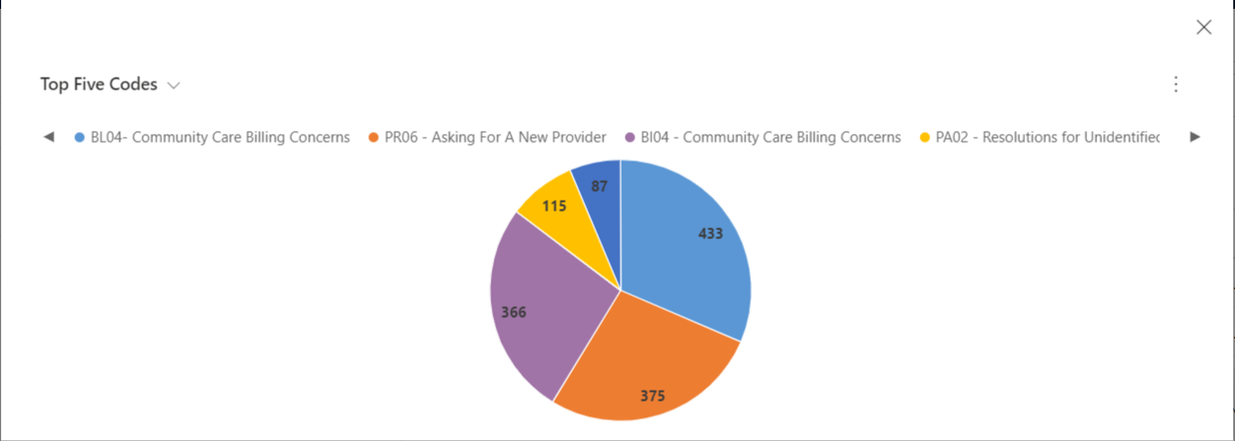
2020 Veteran Concern
22% of overall concerns documented in PATS/R
Notes:
FY 2020 VA Central Ohio Health Care System had 799 (66.58% average per month) requests to assist with Community Care billing concerns (total of 3566)
VISN 10 averaged 5,238 requests to assist with Community Care billing concerns

Slide 8
January 2021 Veteran Concern
13% of overall concerns documented in PATS/R
Notes:
Significant reduction in CC Billing concern since the start of project-Proactively reaching out to Community Care providers-active communication in unresolved case, enrollment into HSRM by Top 5 providers-Billing department
With current Community Care Billing project along with Referral coordination Initiative, positive outlook is ahead and initiative for Veterans to Choose VA for all their care

Slide 9
Conclusion
Less Veteran billing issue that results from closer collaboration with the Community Care Providers along with utilization of HSRM by their billing department and clinics
One stop shop in the Facility will provide convenience for Veterans to come and resolve issues relating to Community Care bills, Community Care Consults/Referral, VA Co-Pay issues.
Close collaboration with Community Care Call Center (C4) and obtained access to CRM that their staff utilize. Community Care staff will be able to retrieve past notes/conversations Veteran had with C4 Staff.
Notes:
In conclusion, result of this project will greatly impact Veterans satisfaction with the VA and the care in the community when necessary. Also, If Veterans do receive bills from the community, they will have a place they could go within Columbus VA to get it resolved. Thank you for your time today.

