Slide 1

VA vs. Community Care (CC): A Comparative Analysis
Laura Mendez, MBA, RRT
GHATP Presentation
STVHCS, San Antonio, TX
March 15th, 2021
Notes:
Hello all! My name is Laura Mendez and I work for the South Texas Veterans Health Care System. As a veteran who receives care solely through the VA, I felt it was important to understand the differences between care in the community and care in the VA. This presentation is a comparative analysis between the VA and Community Care.
The VA has made it a priority to provide veterans with clear information to make informed decisions to choose VA for easy access and greater choice. This starts with ensuring that our Veterans who decide to choose Community Care are doing so with the best information possible. Journey mapping the process in which a Veteran receives care in the community and the clinical outcomes associated with that process will help the VA gain insight on how to move forward with care.

Slide 2

How can you make this work within your facility and what are the benefits?
Increased patient safety with continuity of care
Increased patient satisfaction
Increased positive patient perception
Decreased wait times
Decreased costs
Increased general purpose fund discretion
Notes:
Have you ever wondered about how your VA fares in comparison to the community? There are many benefits to performing a comparative analysis to identify which clinics within your VA may be able to increase productivity and see more patients. They include increased patient safety with continuity of care, decreased wait times leading to increased patient satisfaction and a positive perception from veterans, decreased costs, and an increase in general purpose fund discretion.
With patient perception being a main driver in the community and VA, ensuring our Veterans are satisfied with their care can be analyzed by evaluating consult flow, wait times, patient satisfaction, and capacity. This can give any facility an overview as to whether the resources available could be evaluated, as seen in the next steps, to increase productivity within their VA or if increased CC is needed.

Slide 3
Goals & Objectives
Examine total VA consults vs. consults sent to the community
Evaluate cost per unique in VA vs. cost per consult in CC
Examine VA wait times vs. CC wait times
Evaluate VA Specialty Care Service capacity
Evaluate patient experience with VA vs. CC
Evaluate next steps for improving ease of access and decreasing wait times
Notes:
By comparing Veterans who choose VA to those who choose Care in the Community, it will allow us to provide valued, data driven information to our Veterans as to why VA is the best choice for their healthcare. This data includes a comparison of the number of consults seen in the community vs those seen within the VA, wait times in both CC and the VA, the capacity of VA specialty care, and an evaluation of patient satisfaction in the VA vs CC. While the focus at South Texas Veterans Health Care System was on specific high-risk clinics (based on a higher relative risk and time sensitivity), the clinics are easily interchangeable to gain a different perspective.

Slide 4
Total VA Consults vs. Community Care Consults
Notes:
Evaluating the number of consults pulled for the 4 specific specialty care clinics, the above table shows a comparison of the total number of consults placed. The cost per unique is included as well, showing a significant increase in what we spend in the community vs. what we spend to see patients in house.
For CC- Source: VSSC Consult by Service Name Report
https://reports.vssc.med.va.gov/ReportServer/Pages/ReportViewer.aspx?%2fAccess%2fConsults%2fConsult+-+Service+Name&rs:Command=Render
For VA- Source: VSSC Consult by Stop Code
https://pyramid.cdw.va.gov/?id=d72a6bca-c47c-403f-9de8-103bc0397eaa&type=datadiscovery&type=datadiscovery

Slide 5
VA Wait Times vs Community Care Wait Times
Notes:
Wait times were then evaluated to see the average length of time in days that new patients were waiting until being seen for their appts. The wait time is calculated from the day a consult is placed until the day of the appt. Community care wait times are seen in blue, while VA wait times are orange.
Wait times were calculated from the consult lists by using the file entry date and the scheduled appointment date.

Slide 6
Capacity
Notes:
The FY21 Physician capacity report for San Antonio shows the specified clinics, an overview of their productivity, and whether they were under resourced, over resourced, or an optimized practice.
FY 2021 Physician Capacity Report for (4V17) (671) San Antonio, TX HCS
Productivity data current through 1/16/2021 (FY21 - FP 4 - Pay Period 1)
https://reports.vssc.med.va.gov/ReportServer/Pages/ReportViewer.aspx?/OPES/Capacity/Overview&SpecialtyProgram=Physician

Slide 7
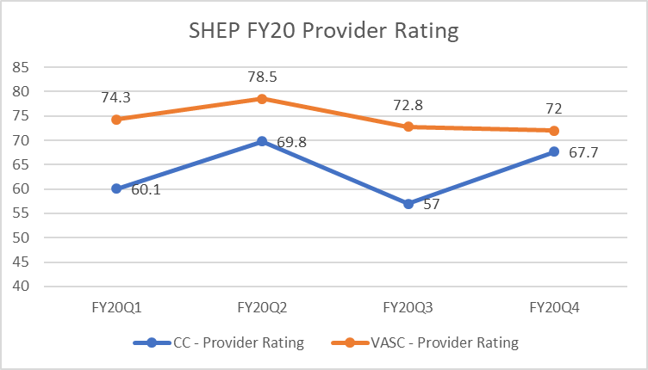
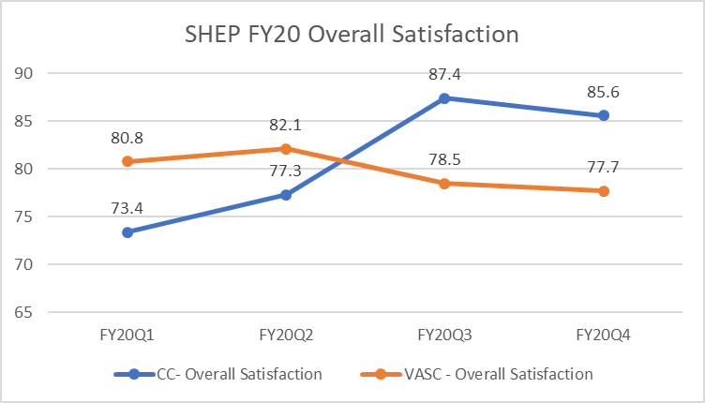
SHEP Survey Results FY 20
Notes:
SHEP survey results for FY20 were pulled to look at patient satisfaction for the provider rating and the overall rating, which were broken down by quarter, the blue line indicating community care results while the orange line indicates VA specialty care results.
For CC- FY20 Community Care Filtered for
https://vaww.qps.med.va.gov/divisions/api/pm/shep/shepCommCareRespLvl.aspx
For VA- FY20 SC Composite & Reporting Measures
https://bioffice.pa.cdw.va.gov/default.aspx?bookid=e71e8f03-6829-403c-b002-b114ae1ac26f|ispasFalse|report8427c340-7848-4f27-a2d1-61dc7dfa3ea1|ws1|wsb0|isDisabledAnalyticsFalse|isDashboardPanelOnTrue

Slide 8
Outcomes
VA sees more than 80% of consults while CC sees less than 20%
Estimated cost per referral in CC is significantly greater than the cost per unique in the VA.
  Potential savings for FY20 had pts been seen in the VA-- $3,366,343.59
Average wait time for VA is less than CC
  Cardiology- 24 days vs. 54 days
  Hematology/Oncology- 22.7 days & 15.4 days vs. 39 days
  Radiation/Oncology- 13.6 days vs. 21 days
  Urology- 26.9 days vs. 74 days
Capacity data shows potential to see more patients
VA rating for providers is greater than CC, however, CC overall satisfaction overtakes VA in last two quarters of FY20
Notes:
After analyzing the data, it was concluded that the VA sees more than 80% of consults placed leaving less than 20% to be seen in the community. Each consult seen in the community costs nearly 50% or more than when seen in house, resulting in a cost of more than $3 million had those consults stayed within the VA. Again, this was only look at 4 specialty care clinics. Furthermore, the average wait time was far less to be seen in the VA vs. being seen in the community. The capacity data shows there is potential to increase productivity, leading to better outcomes for our Veterans.

Slide 9
Next Steps
Analyze clinic workload for under resourced clinics
Identify requirements for physical space if clinic productivity was increased
Analyze clinics which are over resourced for process improvements
Evaluate # of discontinued consults- Was this a possible contributing factor to decreased patient satisfaction?
Evaluate contributing factors- How large of a factor was COVID on increased wait times and decreased patient satisfaction?
Notes:
Moving forward with the data collected from this analysis, the next steps include taking a closer look at the clinic workload for under resourced clinics, identify what requirements are needed for physical space if clinic productivity were increased, analyze those clinics that are over resourced to see if there is room for process improvements, and evaluate why there is a high number of discontinued consults. We want to ensure that our Veterans are receiving the best care, and I know, based on the care I receive, that care is at the VA. That’s why I Choose VA!

