Slide 1
IMPACT OF AUTONOMOUS TECHNOLOGY ON EMS TURN OVER : COST BENEFIT ANALYSIS GHATP: Joseph Misola, MBA Preceptor: Christopher R. Sandles MBA, FACHE South Texas Veterans Health Care System (STVHCS)
Notes:
Hi, my name is Joseph Misola and I am a GHATP here at South Texas Healthcare System. My project is on impact of autonomous technology on Environmental Management turnover using a cost benefit analysis approach.

Slide 2
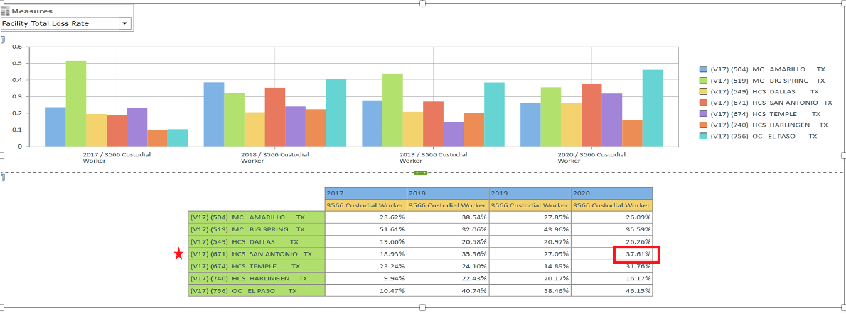
BACKGROUND
South Texas Healthcare System recognized an opportunity with autonomous technology in the Environmental Management Service (EMS) Department. Custodial workers are difficult to hire and retain throughout the VA. Turnover data indicated that EMS had a 32% turnover rate in FY20. With modernization advances in healthcare, it’s essential to find innovative solutions and focus on efficiency where current methods are evolving.
Notes:
South Texas recognized an opportunity with autonomous technology in the Environmental Management Department. Housekeepers for VISN 17 average a 32 percent turnover rate. Here at South Texas, it was 37 percent. That is why it’s essential for us to find innovative solutions to minimize impact during the turnover gap.

Slide 3
BASELINE
Problem Statement: Due to high EMS turnover, floors were not scrubbed consistently. As a result, maintaining floor care was always a finding on the Environmental Rounding reports. We will only focus on general floor care scrubbing at the Audie L. Murphy Hospital (ALM).
Notes:
Due to EMS high turnover, floors were not scrubbed consistently. We were spending approximately 108,000 dollars on floor scrubbing care and it was taking 1-2 housekeepers an average of 90 minutes to clean 3,000 sq. Scope of this project will be floor care scrubbing at the Audie L. Murphy hospital.

Slide 4
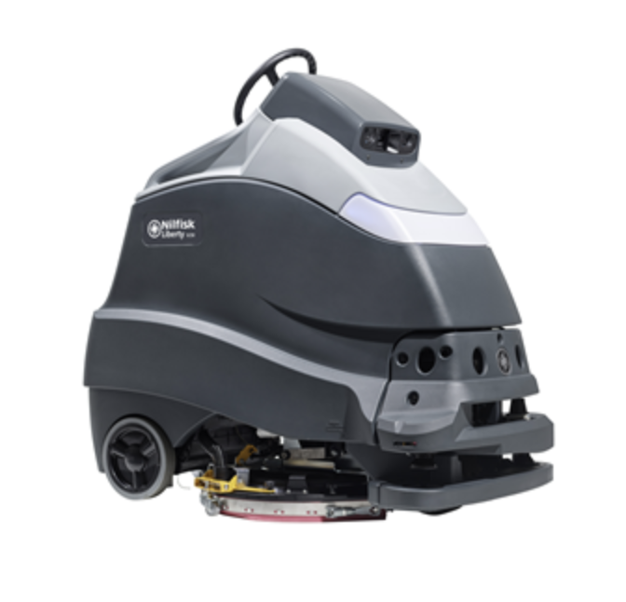
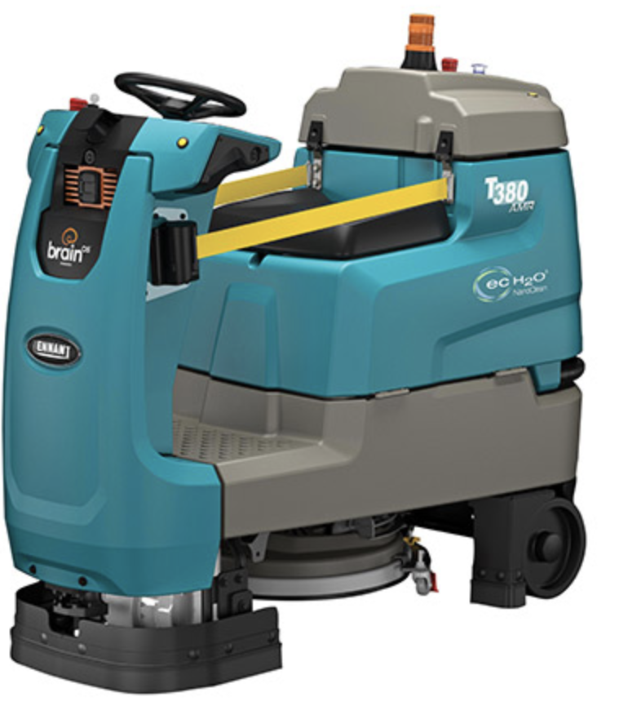
OBJECTIVES
Floors are scrubbed at 100% consistency on a day-to-day basis
Increase floor cleaning coverage by 30%
Improve utilization of current staff levels with supplementation of the autonomous scrubber
Achieve cost savings for Audie L. Murphy hospital
VS
Notes:
Our objectives for this project are for floors to be scrubbed consistently, increase floor cleaning coverage improve utilization of current staff levels and achieve cost savings

Slide 5
TIMELINE FOR COST BENEFIT ANALYSIS
Week 1
Week 2
Weeks 3 -7
Week 8
Week 9
Week 10
BASE CASE
IDENTIFY AND
CATEGORIZED
COST AND
BENEFITS
MONETIZE COST/BENEFITS
DISCOUNT COST AND BENEFIT TO COMPUTE NET PRESENT VALUE
RATE INTANGIBLE BENEFITS WEIGHT/IMPACT AND DECISION MATRIX
MAKE RECOMMENDATION
Conduct time study
Analyze pyramid analytic reports
Determine scope
Moving Forward
Cost Savings
Arrange product demos with potential vendors
Conduct market research
Add cash flows/ out flows
Discount yearly
Direct/Indirect
Intangible/tangible
Create intangible benefit/comparison score sheet
Create decision matrix
Notes:
This is my 10-week timeline, majority of time was spent on monetizing the cost and benefits.

Slide 6
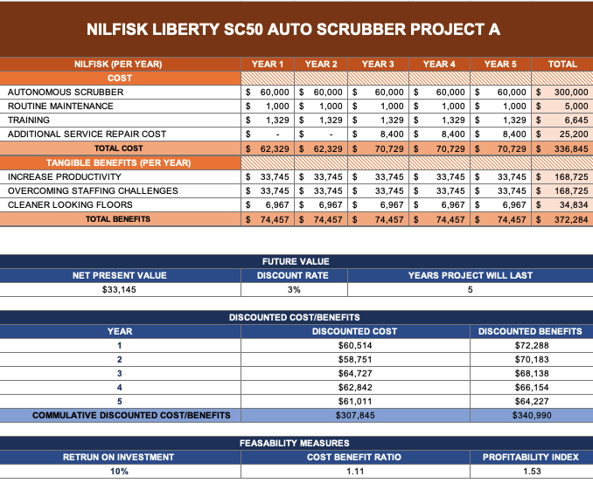
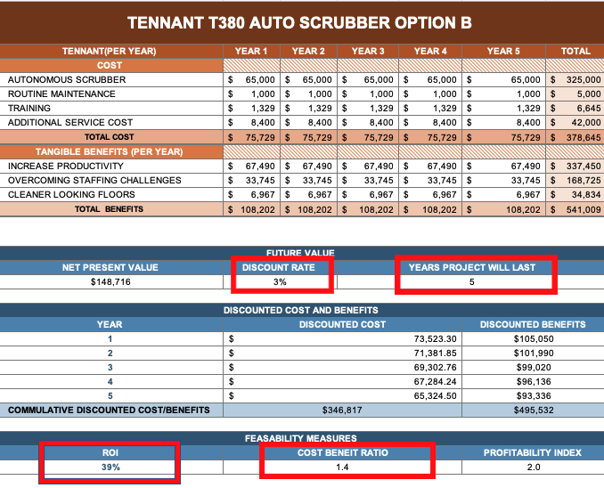
COST BENEFIT ANALYSIS SUMMARY
OPTION A
OPTION B
Notes:
Our analysis show a higher return on investment of 39 percent and a cost benefit ratio of 1:4 in option b discounted at 3 percent over a 5-year project.

Slide 7
INTAGIBLE BENEFITS IMPACT WEIGHT SCORING
Notes:
As we were conducting our cost benefit analysis, we realized that there were many potential benefits we couldn’t add a monetary value to., but they added value. Therefore, we created an intangible benefits score criteria. Left side has potential benefits and right-side product specification benefits. Scoring criteria is 0-10 and all values for each benefit will be entered into decision matrix.

Slide 8
DECISION MATRIX
Notes:
We created our decision matrix which is a combination of weighted and unweighted score. Most of the weight came from our cost benefit analysis. It appears battery run time, subscription based and productivity per hour were the outliers in our decision matrix. Final score of weight plus unweighted was 45 to 47.

Slide 9
RECOMMENDATIONS
Option B is more feasible based on Return on Investment, Cost Benefit Ratio, and our decision matrix
Procure and create implementation plan using using the Define, Measure, Analyze, Implement, and Control methods (DMAIC)
Cost savings – Investing in autonomous technology saves us a projection of 645 annual labor hours (4 hours of autonomous use /$15.00 per hour)
645 annual hours is equivalent to 16.6 weeks of pay amounting to $9,675.00 (Source: braincorp)
Notes:
Based on our decision matrix, option B is more feasible. Moving forward, we will procure and use a system redesign approach to maximize our potential cost savings and potential benefits
Investing in this autonomous technology saves us a projection of 645 annual labor hours with 4 hours of autonomous use at 15.00 per hour totaling to 9,675 dollars.
This concludes my presentation. Thank you.

