Slide 1
The Patient Experience During a Pandemic
Stephanie Mitro Burnett, GHATP 2021
Iowa City VA Health Care System
Notes:
“Hi, my name is Stephanie Mitro Burnett and I am from the Iowa city VA Healthcare System.”

Slide 2
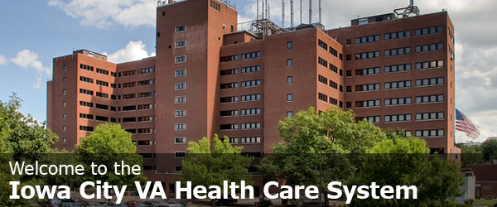
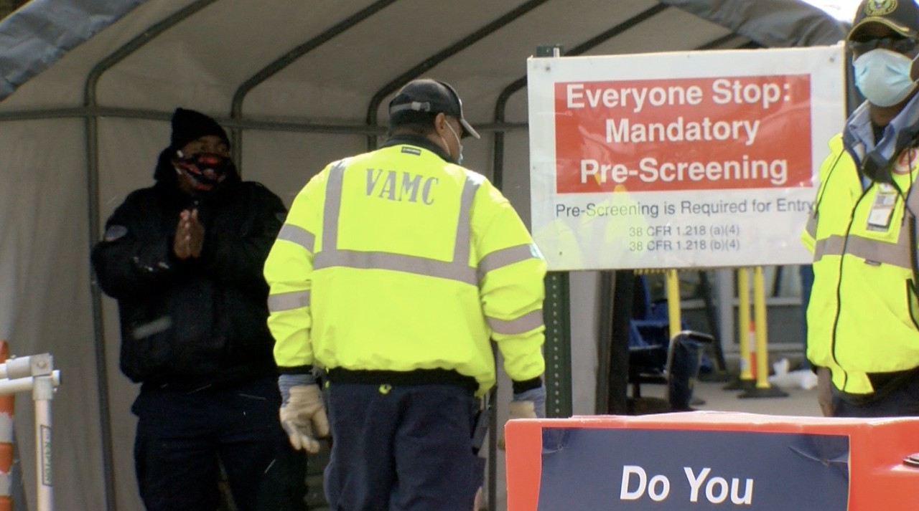
Patient Experience-Health safety screening
“Good morning Sir or Ma’am. What is the purpose of your visit today? Do you have any new or worsening symptoms; fever or flu-like symptoms, sore throat, cough or shortness of breath, nausea vomiting or diarrhea, or loss of taste or smell?”
Notes:
“I would like to discuss the patient experience but before I do that picture this…its -20 F you, a disabled Vet, and your partner are walking into the hospital for an appt. Immediately you are told that your partner cannot enter the facility with you due to policy so they must go back to the car to wait. At the end of the appt you are tired and need to use a wheelchair to exit, now you need to push yourself back out to your vehicle. If someone were to ask you about your visit today, what would your response be? “

Slide 3
“A customer is the most important visitor on our premises, he is not dependent on us. We are dependent on him. He is not an interruption in our work. He is the purpose of it. He is not an outsider in our business. He is part of it. We are not doing him a favor by serving him. He is doing us a favor by giving us an opportunity to do so.” Mahatma Gandhi
Notes:
“Did you know that first impressions are established within the first seven seconds? Prior to the pandemic our scenario above would not have occurred. You would have been able to walk in with your partner and gone about your day. Now you spend those first seconds dealing the with questions and policies you have no control over. First impressions are lasting, but did you also know that it can set the tone for the entire visit? ”

Slide 4
High Reliability Organization
“Affirming the trust of Veterans and their families through the achievement of zero harm and an unmatched experience.”
Notes:
“The VA is a high reliability organization and one of the main values is zero harm. Zero harm begins at the front door. ​”

Slide 5
What does the data show?
During the height of the pandemic in Iowa (fall/winter) with an excess of 20k people entering the facility the Iowa city VA, after a few challenging months in the beginning, was able to provide excellent customer service which you can see reflected above in our scores.
Notes:
“It is no secret that Covid 19 was a learning curve for both patients and staff. The graphs show the number of people that entered the facility and our healthcare visit scores. The beginning of the pandemic was difficult to navigate, which led to confusion and frustration. The facility has worked hard to improve the screening process by providing staff training and improving communication, you can see reflected in our scores during the fall/winter, which was the height of the pandemic here in Iowa. “

Slide 6
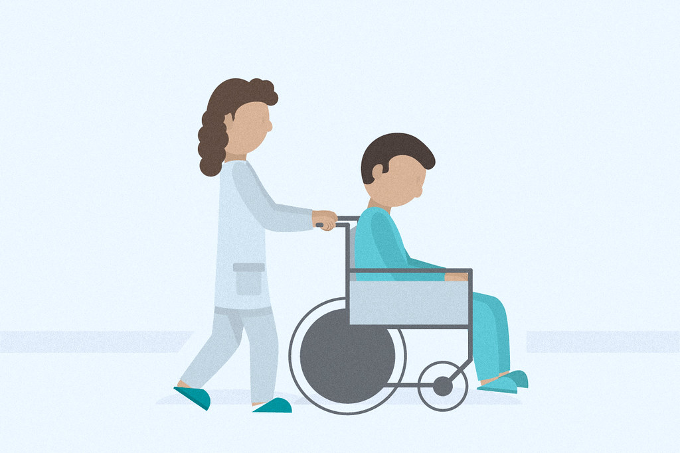
Patient Mobility
Due to loss of temporary employee’s, patients no longer had access to assistance to get in and out of their vehicles.
Due to the collaboration with EMS and myself we were able to convert current temporary employees from a GS to a WG employee so we could incorporate safe patient handling in their duties. This conversion increased the cost in salary to around $2,400/week for 18 FTE, if we were fully staffed at 24 FTE it would be an increase of $3,300/week.
Notes:
“Iowa City now has one of the more robust screening processes in VISN 23. During my observations some issues were brought to light; patient mobility in and out of the facility, and the redcoat ambassador program. Working with our EMS department we were able to convert the current screeners in order to incorporate safe patient handling into their job duties. Now patients can be escorted directly to their cars and assisted into them if needed.”

Slide 7
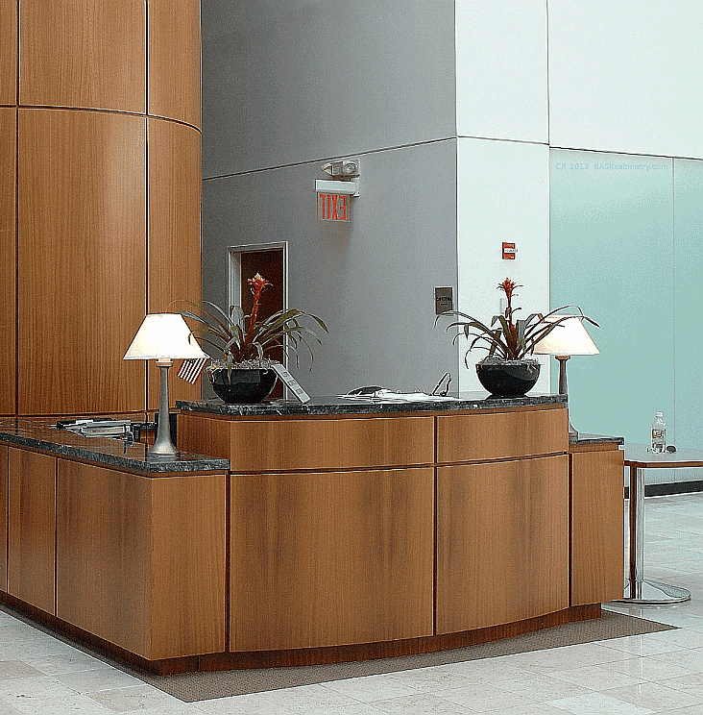
Red Coat Ambassador Program
Pre-Covid, volunteers were not present at the front door to assist patients upon entry into the facility.
The hiring of screening staff brought this issue to light when patients made comments about how much they enjoy having people to assist them right away.
Once Volunteers can have patient contact again the Red Coat Ambassador Program will be enhanced to include a presence at the front door (hospitality/concierge desk) to provide improved customer service upon entry.
Notes:
“Before the pandemic patients had to seek out assistance, now with the screening process assistance is available 24/7. Once we figure out the new normal, and Volunteers can have patient contact again we will work with the Chief of Voluntary to enhance the Red Coat Ambassador Program allowing for Volunteer presence at the front entrance with a designated work area.”

Slide 8
What did we learn?
The patient experience happens everywhere; hallways, bathrooms, elevators, coffee lines, etc.
Small contributions can make the biggest impact.
VHA exists to serve our nation’s Veterans and patient experience starts with hello.
Notes:
“The patient experience happens everywhere, and it is up to us to provide the best possible experience in whatever capacity we can. Remember when you accepted your job, you were excited to work here and help Veterans. Unfortunately, this can become lost amongst the day to day, don’t feel bad it happens to everyone. I challenge you to connect with at least 5 Veterans a week, which is only one patient a day. Not only is this beneficial for the patients it also provides a sense of connection for those employees that don’t get to work directly with them. Patients that feel valued are more likely to choose VA and encourage others to do so. Getting back to the core of customer service is a simplistic process that can have the biggest impact. If we want patients to choose VA, then we must choose VA”

Slide 9
TOGETHER…WE ARE THE PATIENT Experience
Thank you
Notes:
“because together we are the patient experience. “

