Slide 1
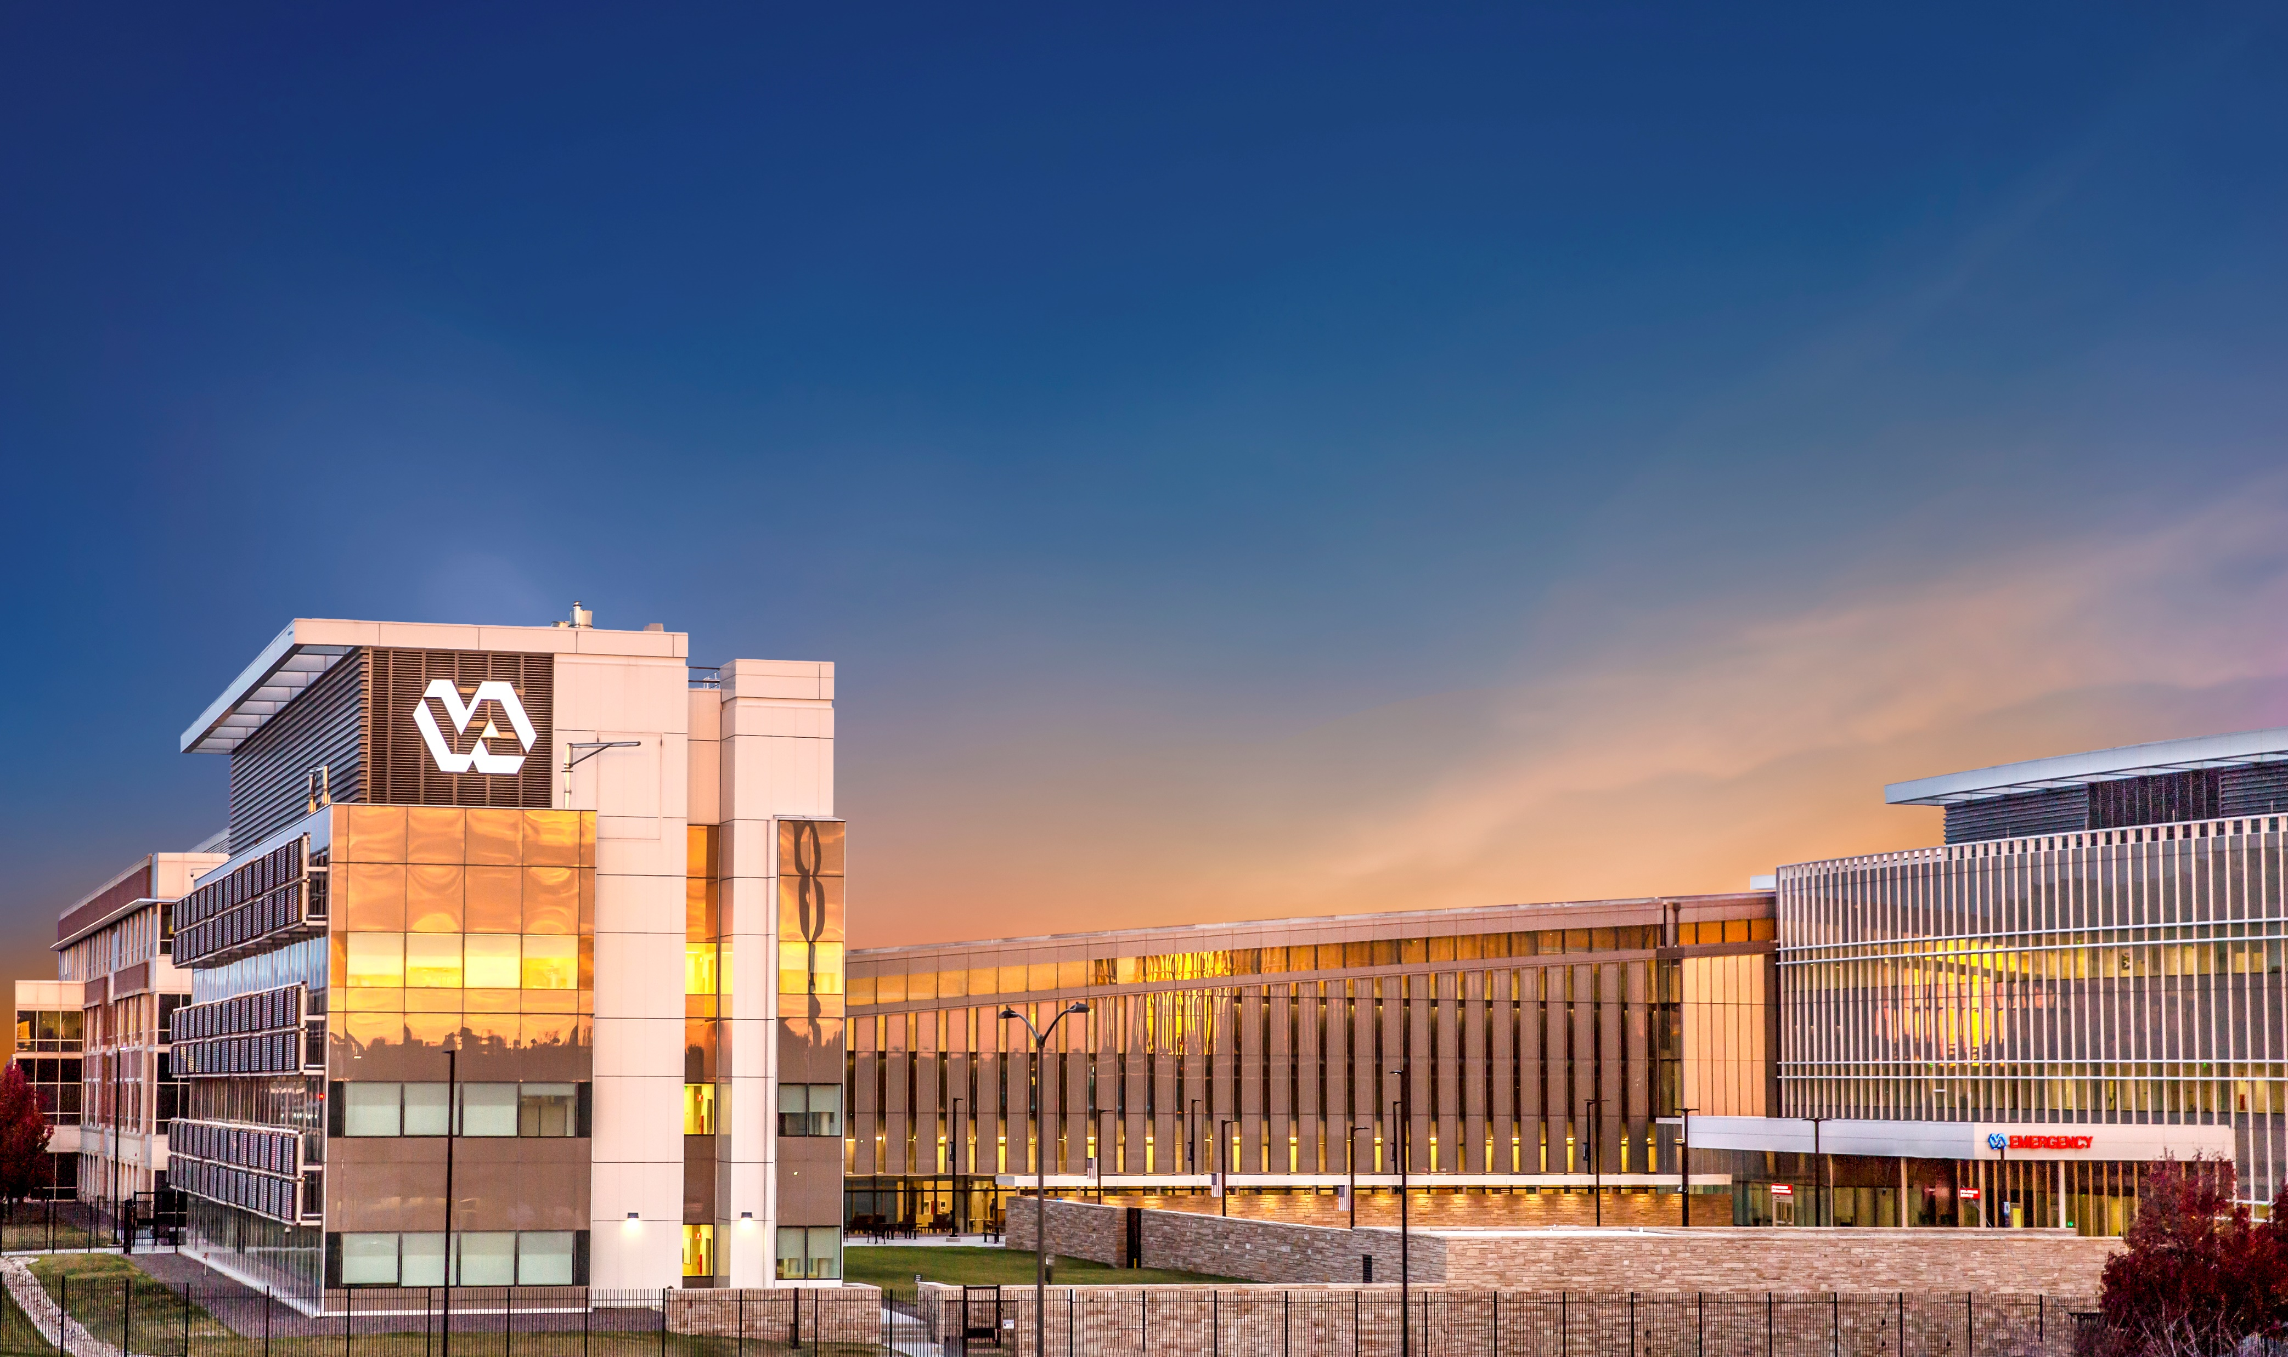


Presented by:
Rachel Newman, GHATP VISN 19 – Denver, Colorado
Preceptor: Mr. Ralph Gigliotti, VISN 19 ND
Co-Preceptor: Mrs. Sunaina Kumar, VISN 19 DND
Co-Preceptor: Mr. Michael T. Kilmer, Director, ECHCS
Notes:
Hi. I am Rachel Newman and I am the GHATP / admin trainee for VISN 19

Slide 2
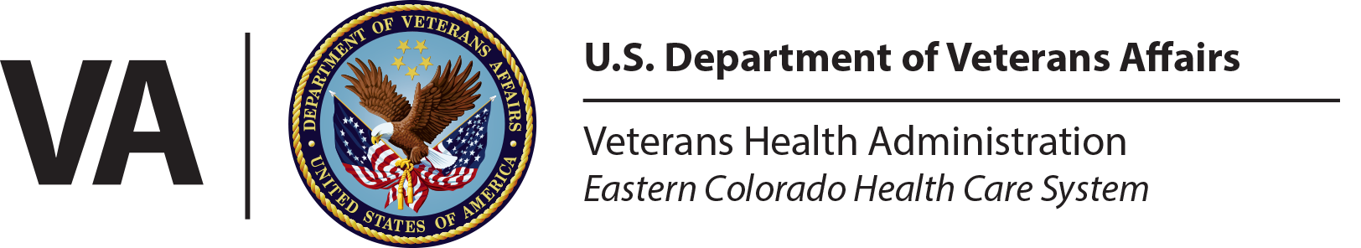
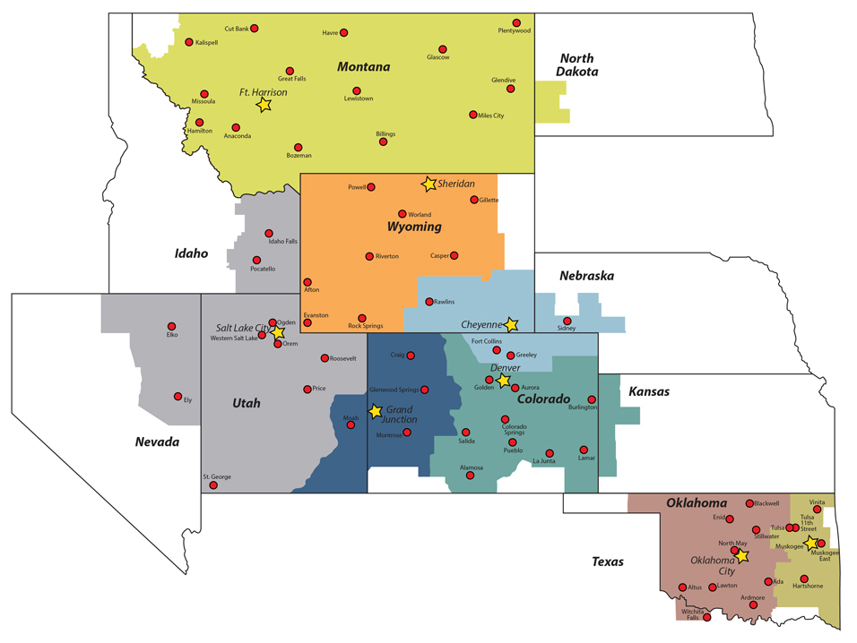
Notes:
VISN 19 is the largest VISN in terms of its geographic area. There are 8 VA Medical facilities located in 5 different states within the VISN. Only three of those VA medical facilities are capable of providing specialty surgical services and are designated as “complex” in terms of their operative complexity

Slide 3
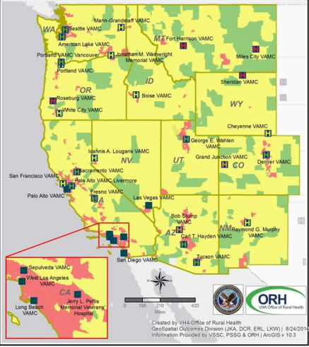

Notes:
Approximately 1 million Veterans live in VISN 19s geographic boundaries. As you can see by the yellow and green areas on the map most of these Veterans are considered to live in rural or highly rural areas where specialty complex surgeries are not available in their communities.

Slide 4
Issues:
Veterans must travel long distances to receive specialty surgical care
Mission Act makes it very easy for Veterans to be sent out to the community for their care
  25 referrals for cardiothoracic surgery & 557 for neurology from Cheyenne VAMC were sent to UCHealth since 2019. UCHealth is located directly across the street from the Rocky Mountain Regional, where the same services could have been provided
The current logistical process for non-beneficiary travel eligible patients is stressful, confusing and time consuming
Notes:
The rurality of our VISN creates many challenges. In order to receive the specialty care they need, our Veterans must travel long distances and sometimes must even be flown out of state for their care. Secondly, with the implementation of the MISSION Act it is easier than ever before for our Veterans to be referred out into the community for their care. Lastly, the current logistical process for our non beneficiary travel eligible patients is stressful, confusing and time-consuming which forces many of our non beneficiary travel eligible patients to decide to be sent out to the community for their care rather then traveling to another VA Medical Center.

Slide 5
Action items:
Different stakeholders together
  Social work, voluntary services, HAS (VTS & BTS), Veteran Experience Officer (Fisher House), Clinical staff, contracting, admin support
Lyft Contract
VTS agreement between our pilot site facilities (Grand Junction & Cheyenne)
Advertising surgical services and travel program to other facilities
Worked with a charity that provided flights for a MT Veteran and his wife to and from Denver for his care
Working on gathering data for a business plan for a Clinical Consult Coordinator (RN)
  Building business case for position, presenting it at ERC, creating PD, working with HR to post it
Notes:
Since being detailed to the Denver VA Medical Center as their GHATP I have been able to revive their concierge travel program. This program brings together many different stakeholders from within the facility to streamline the travel process for our non beneficiary travel eligible Veterans. I also had the opportunity to work with our innovations specialist, contracting and voluntary services to create a contract with a ride sharing service that will provide transportation, for free, for our non beneficiary travel eligible Veterans outside of our normal VTS programs operational hours. I have also worked with the facility’s clinical team to create marketing for our surgical services (cardiothoracic and neurology) for our other VA Medical Centers. I am also especially proud to have worked with a charity that has provided flights for a non beneficiary travel eligible Veteran and his wife from Montana to fly Denver for his surgical care. Lastly, I am working on a business case for a Clinical Consult Coordinator who will be the “one stop shop” for our non beneficiary eligible Veterans and their travel needs.

Slide 6
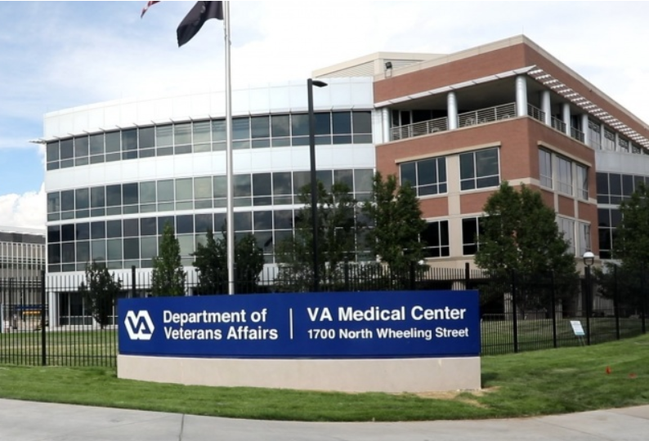
Rocky Mountain Regional Long-Range Goals
Improve and expand stakeholder engagement
Open access to compressive care
Increase and improve the complexity of services
  - FY21 WIG: Increase facility case mix index from 1.59 to 1.70 by 09/30/2021
Become a High Reliability and Value-based organization
Notes:
This concierge travel program is aligned with the Denver VA’s long-range goals. By optimizing the travel process and making it easier for Veterans to choose our facility for their care, the facility will increase and improve the complexity of services they can provide. This program will also help the Denver VA Medical Center to reach its 2021 WIG of increasing the facility’s case mix index from 1.59 to 1.7

Slide 7
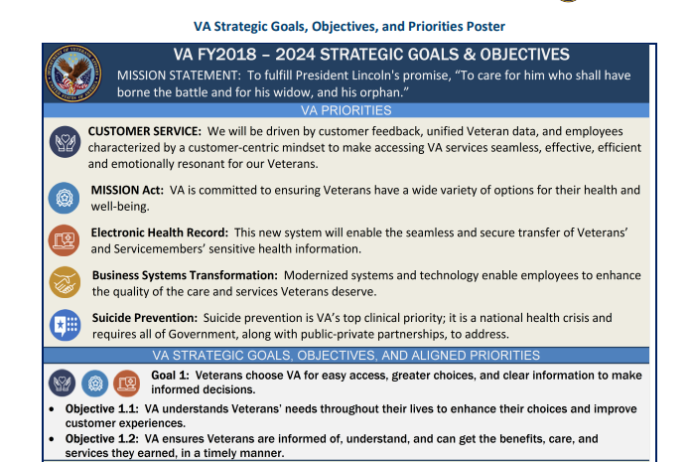
Notes:
Lastly, this program is also aligned with the strategic goals and objectives of the VA. By keeping patients within the VHA we will provide a better continuity of care. It also saves taxpayer money by providing the same services in the VA at a lower cost than the community. This program also improves customer service but making the travel process easier and less stressful for our Veterans.

Slide 8
Contact Information
Rachel.Newman@va.gov
Thank you to my preceptors, Mr. Gigliotti, Mrs. Kumar and Mr. Kilmer. I would also like to thank all the unofficial mentors who have guided me along this process and everyone who helped with the concierge travel program.
Notes:
Thank you to my preceptors, Mr. Gigliotti, Mrs. Kumar and Mr. Kilmer. I would also like to thank all the unofficial mentors who have guided me along this process and everyone who helped with the concierge travel program.

