Slide 1
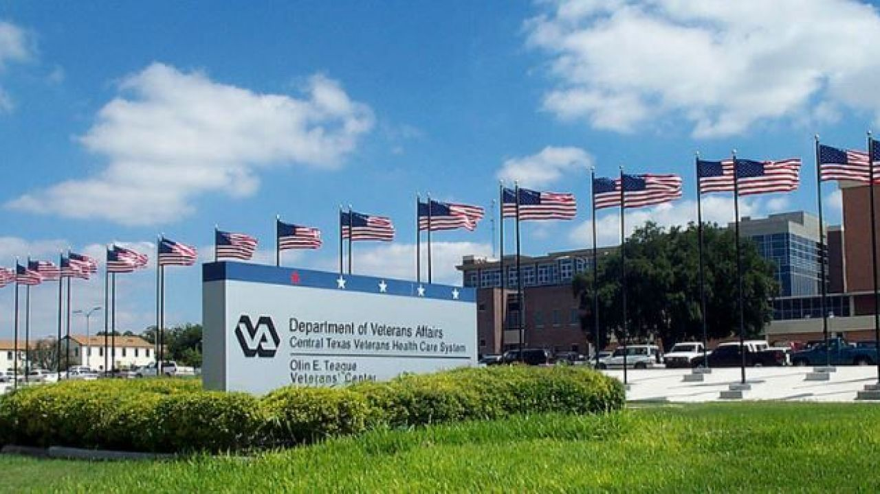
Optimizing the Community Living Center (CLC) Practices: To optimize the Length of Stay and achieve High-Reliability outcomes
Andrew E. Okemwa, MPH,
GHATP Administrative Fellow
PRECEPTORS:
Michael L. Kiefer, MHA, FACHE,
Director, CTVHCS
Robert A. Farias, MHA,
Executive Assistant to the Director
Central Texas Veterans Health Care System
(CTVHCS) VISN 17
Notes:
Hello, my name is Andrew Okemwa, and I am the GHATPs at Central Texas Veterans Health Care System (CTVHCS) located in Temple, Texas, VISN 17.
This project shall look at the admission and discharge process to the Community Living Center (CLC), examine the Length of Stay (LOS) and a way to streamline and improve the process.

Slide 2
The Optimization Procedure in CTVHCS Examine admission & discharge standards for process improvement and efficiency
Social Placement
Central Texas Veterans Health Care System has a high number of Veterans in the CLC that qualify as continuing care social placements not meeting CLC admission criteria.
Length of Stay/ Bed Utilization
Admission inefficiencies lead to social admissions and placements to the Community Living Center (CLC) increasing the Length of Stay (LOS) to both the hospital and CLC and missed patient care opportunities.
VERA Disbursements
Admission inefficiencies reduce access to beds, continued care and follow-up resulting in reduced Veterans Equitable Resource Allocation (VERA) disbursements
Notes:
There are several factors that increase the length of stay (LOS), minimize access to beds, care, including staffing ratios contributing to inefficient Veteran Equitable Resource Allocation (VERA) disbursements which can differ dramatically as 1 day could make $35,000 difference in the reimbursement for a patient.

Slide 3
Goal and Objectives
Establish neighborhood specialties and scope for each treating condition for improved access and Quality of Care.
VA Strategic Goal 4:
Modernize Systems
Provide educational intervention for process improvement leading to better Veteran care, access to greater Veterans Equitable Resource Allocation (VERA) disbursement.
VA Secretary Priority 4:
Infrastructure Improvements
Develop process to review all admission & discharges to ensure that all admissions and discharges meet new defined criteria reducing ineligible admissions, length of stay (LOS) and wait times for beds.
Implement the improvement opportunities to ensure access and resources are provided for Veteran Experience.
Notes:
My objective is to establish neighborhood specialties for each treating condition, optimize access to care, streamline the (LOS), wait times for beds and increase Quality of Care.
Veterans’ Health Administration (VHA) Strategic Goal 4 highlights the importance of Modernization and infrastructure improvements for better access and quality of care.
135 Community Living Centers (CLC), provide care to more than 13,000 Veterans costing $8 billion per year.
With 45% over the age of 65 and users over age 85 expected to exceed 1.2 million by 2034.

Slide 4
Data Collected: Example of CTX Gains/Loss applying all principles
Apply
HRO Principle
Get the Root Causes
Focus Resources More Efficiently
(Days)
Veteran Equitable Resource Allocation (VERA) disbursement per patient by Length of Stay (LOS)
4
Notes:
Using High Reliability Organization (HRO) techniques, getting to the root cause, knowing that it is all about the Veteran, a Short Stay Rehabilitation patient’s Veteran Equitable Resource Allocation (VERA) disbursement show a, $35,000 difference between day 27 and day 28, showing the wrong Resource Utilization Group (RUG) applied or the patient is in the wrong treating specialty.
This tipping point may indicate inefficient resources from inadequate staffing to poor quality of care, can trigger adverse events such as infections or falls, needing additional resources to repair damages.

Slide 5
Data Collected: Review of 656 admissions from FY18Q4 – FY20 330 Veterans did not stay more than 28 days
CLC Specialty Data Comparison | CTX | VHA | Average Cost per Bed Day | CTX Average Length of Stay | VHA Average Length of Stay
HOSPICE | 27.8% | 16.90% | $1,873 | 31 | 33
NH GEM NURSING HOME CARE | 0.5% | 1.50% | $1,950 | 34 | 19
NH LONG STAY DEMENTIA CARE | 6.0% | 5.10% | $1,368 | 352 | 110
NH LONG-STAY CONTINUING CARE | 12.5% | 21.90% | $1,470 | 226 | 105
NH LONG-STAY MH RECOVERY | 1.2% | 1.50% | $1,242 | 125 | 129
NH SHORT STAY DEMENTIA CARE | 1.8% | 0.70% | $1,429 | 53 | 65
NH SHORT STAY REHABILITATION | 23.2% | 28.00% | $2,198 | 37 | 18
NH SHORT STAY SKILLED NURSING | 15.3% | 15.00% | $2,209 | 32 | 24
NH SHORT-STAY CONTINUING CARE | 11.5% | 4.30% | $1,652 | 52 | 41
NH SHORT-STAY MH RECOVERY | 0.3% | 1% | $1,889 | 50 | 41
Resource Utilization Group (RUG) help determine:
Staffing Methodology
Change of Treatment Specialty
Discharge Planning
VERA Resource Allocation
Length of Stay (LOS)
These gaps indicate the Opportunities for optimization
May Indicate not in Correct Treating Specialty
Community Living Centers RUG Score and Treating Specialty (TRT) (va.gov)
VHA Handbook 1143.03 1142_03_HK_2013-01-04.pdf
Notes:
I reviewed 656 admissions from FY18Q4 to FY20 finding 330 Veterans did not stay more than 28 days, revealed Short Stay Continuing Care patient staffing ratio higher at 11.5% compared to Veterans Health Administration (VHA) averages of 4.30%.
Length of Stay (LOS) averages were double the Veterans Health Administration (VHA) averages at 4 specialty and triple at one.
With an Average Cost per Bed day of $1727, these specialty care potential cost exceeds the Veteran Equitable Resource Allocation (VERA) disbursements indicating Veterans in the wrong specialty, or more likely, social placements.

Slide 6
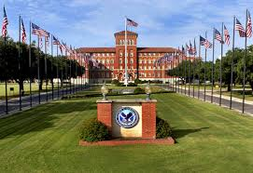
Recommended Neighborhood Specialties Designations to Maximize Utilization
Waco, TX
Building Location | Recommendation for Maximize Utilization
Bldg. 11A | Short Stay/Long-stay dementia care - residents based on FAST Score (less severe)
Bldg. 11B | Short Stay/Long-stay dementia care - resident based on FAST score (more severe)
Bldg. 91AS | Short Stay skilled nursing (non-complicated)/Short-stay continuing care and short-stay restorative care. Long-stay continuing care transition to the CLC as their permanent residence (the term social placement is not used in CMS LTC)
Bldg. 91AN | Short-stay mental health recovery – No dementia conditions (Non-aggressive)
Bldg. 91BS | Short-stay mental health recovery – No dementia (Aggressive)
Notes:
I propose establishment of specialty neighborhoods to facilitate in providing Veteran-centered care, minimizing poor resource utilization based on severity, appropriate staffing embracing VHA Strategic goal 4 on focusing resources.
This would realign those Veterans that may be in the wrong specialties access need services, slenderize the Length of Stay (LOS) and maximize Veteran Equitable Resource Allocation (VERA) disbursements while increasing customer service as well, one of the VA Priorities.

Slide 7
Specialty Neighborhoods: Roadmap to Interventions
HRO Theme | Admission Process | Treatment/Rehab Process | Discharge Process (Redesigned)
Anticipate Risk Every Staff Member is a Problem Solver | To make neighborhoods functionally oriented include all stakeholders in admission/discharge process and plan (Physician, Nursing, Social Worker, Therapist, Family Members, Home Health Aide etc.) |  | Incorporate Functional Assessment Staging of Alzheimer’s Disease (FAST) in process and teach family members to recognize decline
Visual Cue for Process Improvement | Meet Minimum Data Set (MDS) documentation requirements (Assessment, Care Plan, Quality indicators, as generate a RUG) | Establish informational flow chart displaying Admission to Discharge process - constant education & reminder leading to better Quality of Care and increased Veteran outcomes | RUG level could be indicator of readiness for discharge
Focus on Front Line Staff and Care Processes | Resource Utilization Group (RUG) determines staffing needs |  | Individualized care plan with Home Health Aide
 | Establish best utilization of CLC resources (Short Stay, Long Stay, mixed population) trained with appropriate equipment |  | Continued access to medical equipment (walkers, commodes etc.)
Notes:
Interventions to implement include:
Adding Functional Assessment Staging of Alzheimer’s Disease (FAST) score and the Resource Utilization Group (RUG) to Discharge process aiding family members to continue treatment after discharge and track decline of loved ones supporting VHA Strategy 2 emphasizing support to caregivers and care of aging Veterans
Modernizing the length of stay (LOS) requires reducing:
Communication gaps between providers, nurses, case workers and transportation services as patients not discharged by Friday, would still be in the hospital the following Monday.

Slide 8
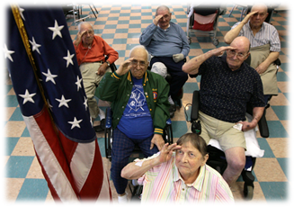
Benefits and Outcomes
Facility Level | VISN Level | National Level
Examine admission & discharge standards for process improvement and efficiency | Examine and compare CLC achievements and resource utilization
Educate and engage various stakeholders from physicians, social workers to the family members when establishing the discharge plan | Find and fill gaps in CLC care, such as dementia notation, treatment and care | Ensure that the Veteran is getting all the best access and resources to treatment available to them that the CLC can provide
Establishment of specialty neighborhoods facilitate in providing greater for the Veteran | Potential for VERA disbursement practices to be maximized
HRO Value
Sensitivity to Operations
To maintain consistent focus on front line staff and care processes. Leaders and staff members across all levels are mindful of all people, processes and systems that impact patient care.
Applicable to 135 VHA Community Living Centers (CLC) in the nation.
It’s All About the Veterans
Notes:
I designed an admission and discharge flowchart pamphlet for providers, staff and caregivers.
Applicable to the other 135 Community Living Centers (CLCs), designed to optimizing resource allocation, reducing total cost of care by refining admission through discharge steps incorporating Functional Assessment Staging of Alzheimer’s Disease (FAST) score, Minimum Data Set (MDS) and Resource Utilization Group (RUG) diminishing length of stay (LOS), have significant financial impact to VHA resources such as staffing and VERA disbursement emphasizing Veteran centered priorities, placing the focus on customer service and Veteran-centered care.

