Slide 1

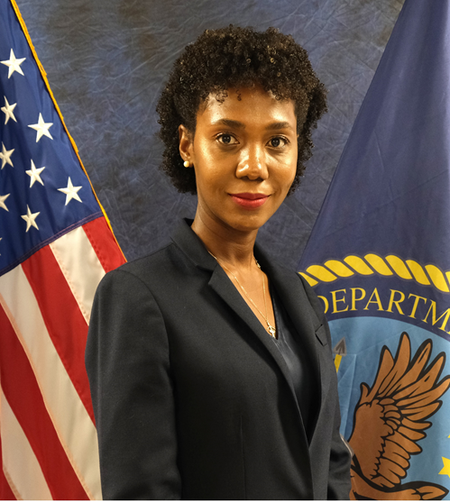

Management of Community Care Mammography Consult
Ms. Nerlande Pierre, MBA
Graduate Healthcare Administration Training Program Fellow
Veterans Healthcare System of the Ozark (VHSO) Fayetteville, Arkansas
Notes:
My name is Nerlande Pierre, GHATP Fellow at the Veterans Health Care System of the Ozarks located in Fayetteville Arkansas. My Project is “ Management of Community Care Mammography Consult.”

Slide 2

MY Team Members / CO-contributors
Dr. James Slezak, MD
Ms. Kristy Pullin MSN,RN
Mr. Timothy Hagen MBA
Ms. Brenda McReynolds, LPN Ms. Michiele Schrieber MS
Ms. Sherri Jackson MSN, RN
Ms. Rachael Powers, RN
Ms. Lynette Reilly RN
Ms. Doris Kaufman RN
Ms. Dawn Michel, MSN, RN
Dr. Jennifer Turner Ragsdale
Ms. Kendra Dial, BSN, RN
Ms. Amy Huycke, MS, RN, ADPCS, Executive Sponsor
Notes:
Before I get started, I want to give a special thank you to my team members and co-contributors for assisting me on this project.

Slide 3
PROBLEM STATEMENT
VHSO had a fragmented process that involved several staff from multiple services. This, along with inconsistent documentation, created a cumbersome workflow as well as opportunity for error.
Due to non-standardized processing of results,
urgent patient care needs are not timely addressed. ​
Notes:
Why did I select this project this project for my GHATP fellowship? Well, the answer “VHSO had a fragmented process Mammography Consult process , along with inconsistent documentation, creating a cumbersome workflow and therefore urgent patient needs were not timely met.

Slide 4
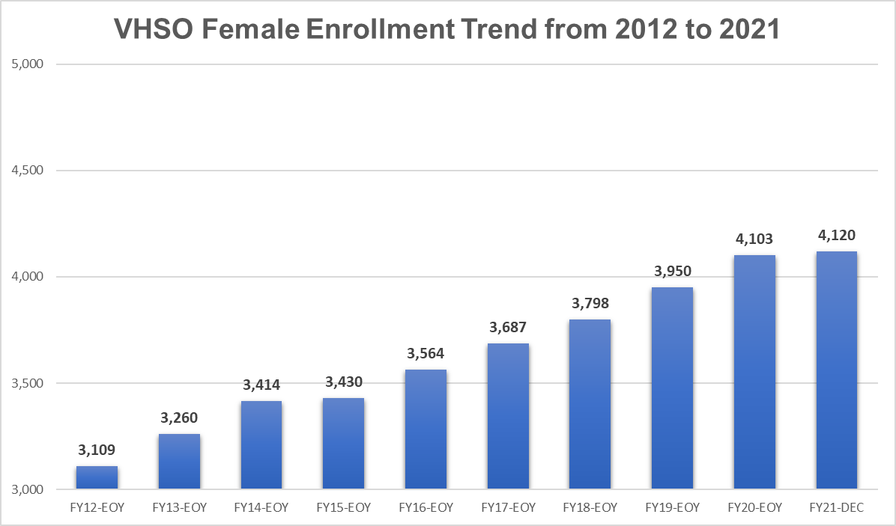
The WAY – Reason for improvement
Women Veterans are the fastest growing population in the US
VHSO Stats of Female Veteran Patient enrollee trending upward
Notes:
My why? The data shows Women Veterans are the fastest growing population in the united states. Here at VHSO our Women Veterans patient enrollees have increased by over 30% in the past decade. And based on our projection model, we expect an additional 9% growth through 2032.

Slide 5
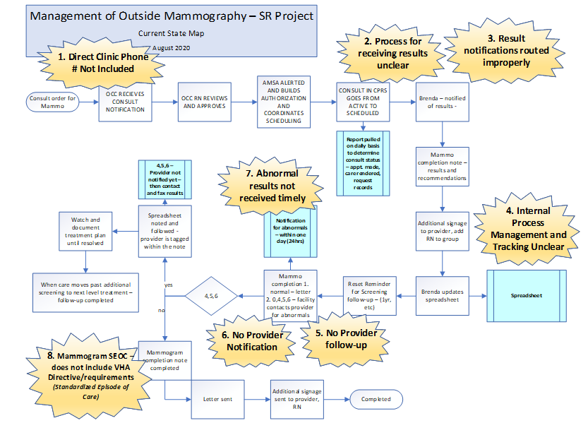
Current state
Identified Problems
Direct Clinic phone # not included
Process for receiving results unclear
Result notifications routed improperly
Internal process Management and tracking unclear
No Provider follow-up
No Provider Notification
Abnormal results not received timely
Mammogram SEOC – does not include VHA Directive/requirements
Notes:
How are we addressing the mammography consult issue at VHSO? Looking at the current state map – you can see 8 identified Kapowees listed in yellow- e.g., 1. Direct Clinic phone number not included in the consults. 7. Abnormal results not received timely.

Slide 6
Focused Solutions Approach
Notes:
What is the solution? I focused on three areas for my solution approach: Communication, Systems and Training.
Like example two: Process for receiving results unclear. That is a communication problem
Or number five: No provider follow up. That barrier can be resolved with proper training. With that, continuous step-by-step training is available outlining lean process integrating SMART note.

Slide 7
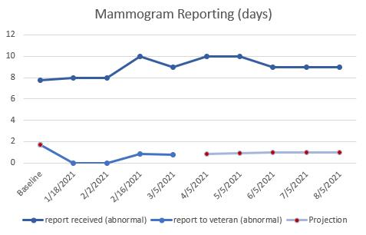
Focused Solutions Approach
Notes:
Please note: We are only 6 months in on this project with a very low N, but the projections based on the last two data points is, the process will continue to stabilize and maintain a minimum one-day reporting of results to Veterans, which is a seven-day improvement!

Slide 8

Thank you for your appreciated attention
Questions?
Notes:
Thank you for your attention. If you are interested in those project for your Medical Centers, please contact me.

