Slide 1
Clinic Space Utilization & Labor Mapping
Presenter: Christopher Pugh
Notes:
Good day, my name is Christopher Pugh, and I am with the VA North Texas Health Care System. My GHATP project is Clinic space utilization & labor mapping.

Slide 2
Problem Identifying rooms
Clinical Space and Efficiency
No working diagram of clinical space
No real room assignment by services
Services appt schedule not matching rooms usage
Notes:
For 60 days I walked the outpatient clinic once in the morning and once in the afternoon. I discovered there was no real time room assignments for services, clinic fighting over space, staff members in rooms that could be use for patient care, clinic start times was different from the time they started seeing patient. When providers call out from work, there is no way for other service to know that room are available for scheduling or possible seeing walk in patients.

Slide 3
Archibus Web-Base
Comprehensive and real-time activity data
Tracks services assigned to rooms, patient scheduling, and Idle room times
Highlight Occupiable Vacant Rooms
Provides an accurate picture of both planned and actual activity
Notes:
After discovering these issues, I wanted to come up with a solution. I found a few Web-Base products that would allow the facility to assign and track rooms in real time “Archibus”, a software that can also be used by everyone in the facility to see what room are available and to make request for room assignments.

Slide 4
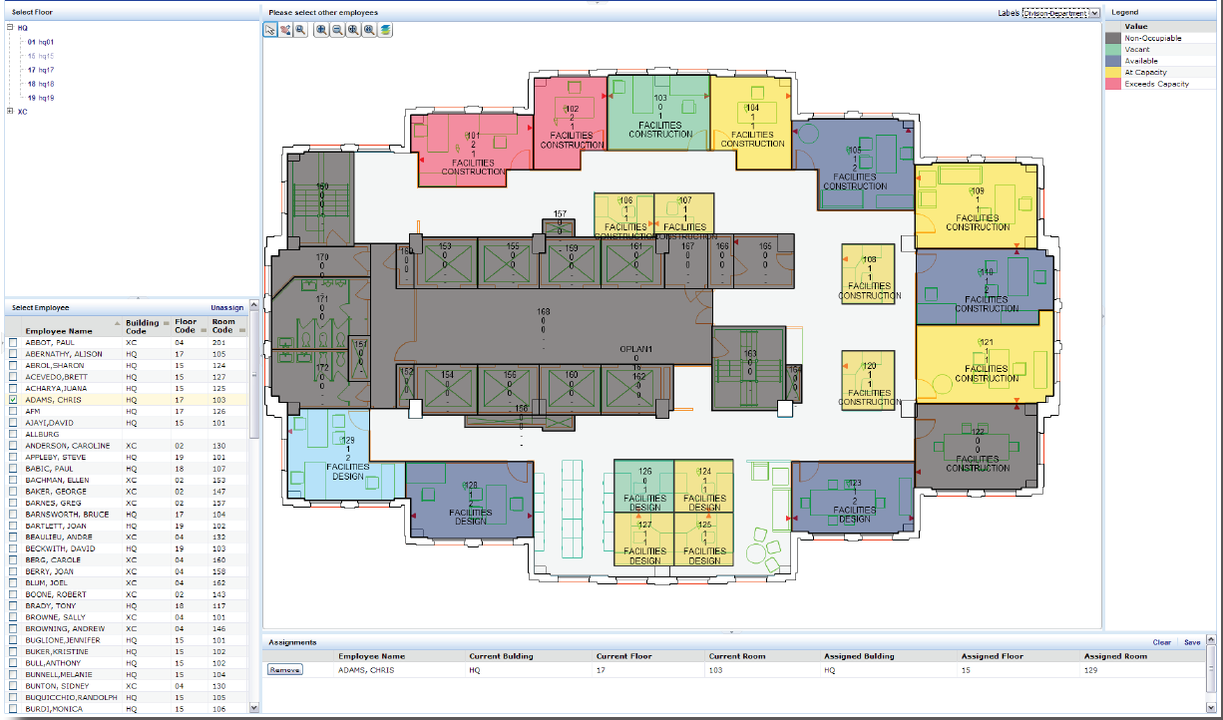
Web Base Live Diagram
Notes:
This is a live diagram, this is what everyone in your facility will be able to see. The diagram shows who’s in a room, what rooms are available, the time the rooms are being used, the day of the week the rooms are being used. Data of what is in each room i.e., exams tables, and treatment room.

Slide 5
Obtaining A Web-Base System
Maximize current workspace
Improves patient scheduling
Help improve forecasting for future needs availability and planned occupancy growth
Simplifies assignment of services temporary or permanent available space by highlighted drawings
Communicates occupancy information easily and timely by personalized, intuitive Web-Based forms, summary tables, and reports
Notes:
By obtaining a Web-Base system it will help leadership in determining what outpatient services needs are for rooms, and properly assigned the rooms to the outpatient clinic. This will help increase scheduling with clinic with higher volume of patients, the systems can provide down time and how long the room has been available. Web-Base system can also help with future planning for increasing patients care and shows anyone who has a need for a room what rooms are available by day and time.

Slide 6
Highlighted Common Area Rooms
Notes:
Here is another diagram of highlighted common areas rooms that shows what rooms are being used most frequently, you can also predict what rooms may become available by looking at this diagram.

Slide 7
Costs
The estimated cost $75k Base price without add-ons
Add-ons room monitoring devices :
Heat sensor
Motion detection
PIV Card readers to access room
Notes:
The cost is estimated at $75,000 that includes the software, diagram of the rooms, labeling the rooms, the room assignments of the services and the equipment in the rooms. There is also add-on features that allow live time information such as Heat Sensor, Motion Detection, and PIV Card readers to access rooms at additional cost.

Slide 8
Web-Base System Summary
Provides an accurate picture or layout of room utilization that allows the facility to validate occupancy quickly and monitor allocations
Helps monitor occupancy and utilization rates as well as remove vacancies.
Provides a shared, centralized space inventory database helps managers find space to increase patient scheduling
Reduce Appt scheduled wait time
Provides self-service access to space data that serves multiple departments/services needs.
Notes:
A Web-Base System for utilization can paint a clear picture for your staff and to leadership and help leadership with assigning rooms for high volume clinics. The system can also help managers find space to increase patients scheduling and reducing appointment scheduled wait time to provide a better service to our veterans.

