Slide 1
High Reliability Organization: From Practice to Permanence
Donovan Sandrey
GHATP Trainee
Montana VA Healthcare System
Preceptor: Judy Hayman
Medical Center Director
Co-Preceptor: Daniel Caufield
Associate Director

Slide 2
Source: The Financial and Human Cost of Medical Error, Betsy Lehman Center for Patient Safety, June 2019
TOTAL: 61,982 Medical Errors Totaling $617M in Avoidable Costs Equivalent to $658.5M in 2021 $

Slide 5
Option 1
Web based interactive algorithm
Unknown security/access
Option 2
Excel Spreadsheet w/auto calculate on select
Not user friendly
Option 3
Fillable .pdf with hidden branching logic
Intuitive for the user
Not intuitive, user has to know where to look
Not easily reset or walked back
Secure, locally managed
Printable for use with employee/Systems Redesign Coordinator
Newly restructured IT processes without how to guides
Maintenance undefined for responsibility

Slide 6
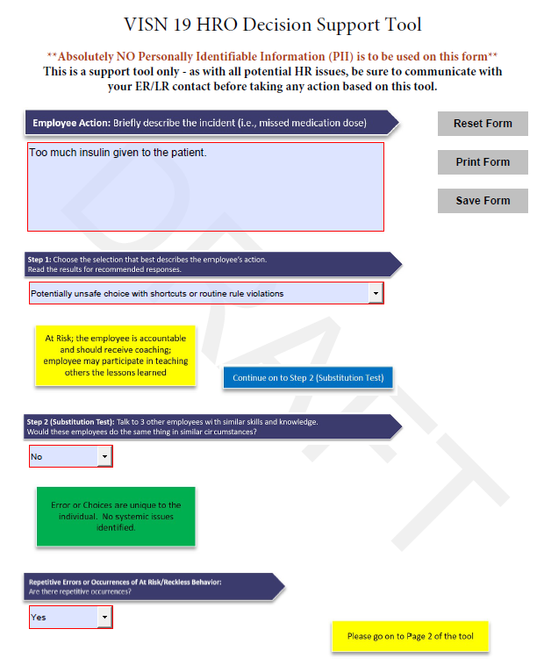
Systems Redesign
High Reliability Organization
Culture of Safety and Improvement
Branching logic depending on inputs matching with RECOMMENDED actions directly from the nationally approved algorithm

Slide 7
Local High Reliability Organization (HRO) Workgroup
VISN HRO Workgroup
VISN
Designated Learning Officer
Implement!
Final Approval
National HRO Workgroup
Employee Relations/Labor Relations

Slide 8
Next Steps
1st Trial: Medical/Surgical Ward
Employee perception of reporting incidents and near misses = automatic disciplinary action
2nd Trial: Inpatient Behavioral Health
Employee culture of increased employee vs. employee conflict resulting in distractions to safe patient care
3rd Trial: Facility-Wide Deployment
Track facility trends for outliers, monitor progress and modify approach as needed for wider deployment

Slide 9
Sources
Betsy Lehman Center for Patient Safety (2019, June) The Financial and Human Cost of Medical Error Betsy Lehman Center Website
https://betsylehmancenterma.gov/assets/uploads/Cost-of-Medical-Error-Report-2019.pdf
VA National Center for Patient Safety (2020, January 28) Just Culture Decision Support Tool VA High Reliability Organization SharePoint
https://dvagov.sharepoint.com/sites/OHT-PMO/high-reliability/Documents/Just%20Culture%20Decision%20Support%20Tool%20(DST)%20Jan2020.pdf
VHA Directive 1026.01: VHA Systems Redesign and Improvement Program (2019, December 19) VHA Publications
https://www.va.gov/vhapublications/ViewPublication.asp?pub_ID=8594

