Slide 1


Community Care Leadership Dashboard
Lauren Tull, MHA
Graduate Healthcare Administration Training Program Fellow
Eastern Oklahoma VA Healthcare System
March 2021
Notes:
Hello, My name is Lauren Tull. I am the Graduate Healthcare Administration Training Program Fellow for Eastern Oklahoma VA Healthcare System. Today I will be discussing the Community Care Leadership Dashboard.

Slide 2
Goal
To provide Executive Leadership and Service Chiefs with a snapshot of information on referral patterns in community care to make time sensitive changes to reduce and control costs.
Notes:
The community care leadership dashboard is intended to serve as an easily accessible resource to provide Executive Leadership and Service Chiefs an overview of referral patterns in community care. The dashboard identifies increases in community care consults and facilitates time sensitive changes to reduce and control costs associated with community acquired consults.

Slide 3
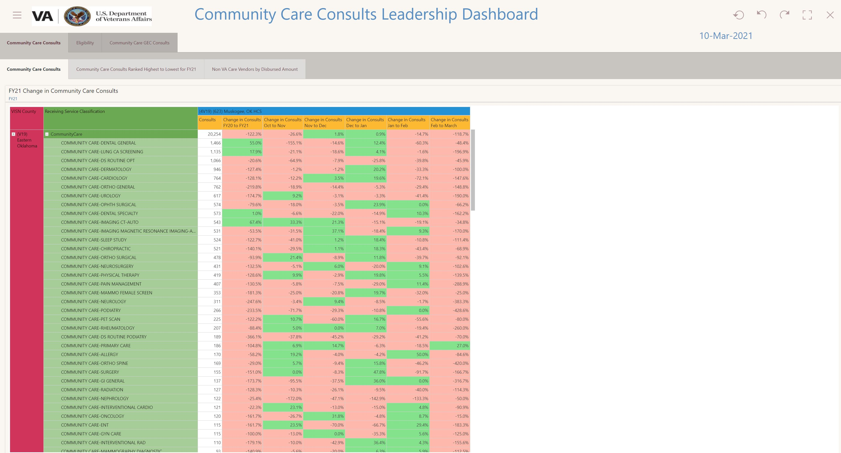
Notes:
The homepage on the dashboard shows the change in the number of consults from month to month sorted by the services with the highest number of consults. If the number of consults exceeds the number of consults from the previous month the box will change from red to green visually alerting the viewer. The indicator serves a notification to evaluate the opportunity to prioritize specific services or reallocate resources to reduce the number of consults sent to the community.

Slide 4
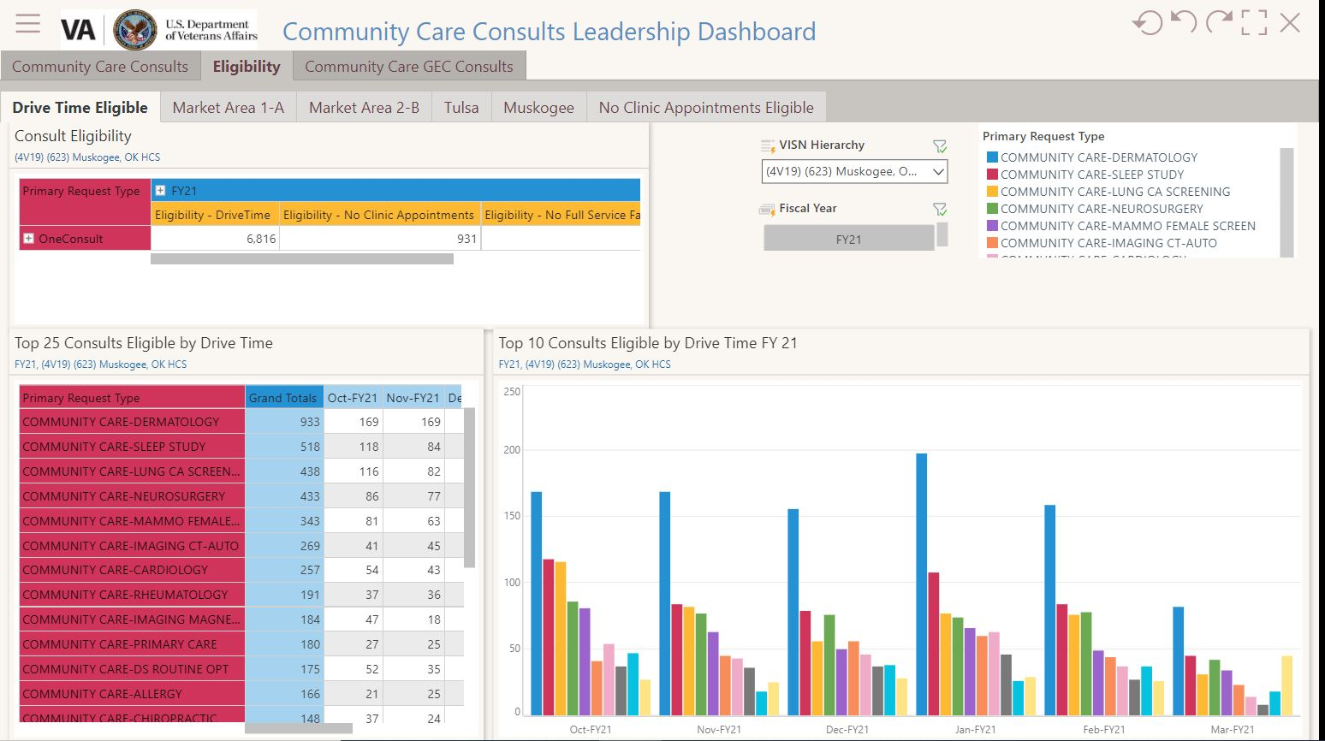
Notes:
The dashboard also tracks consult eligibility due to drive time and appointment availability. Since drive time eligibility is most common, the dashboard indicates the most common consults for each market area for our facility, providing insights into which services may need to be added or expanded.

Slide 5
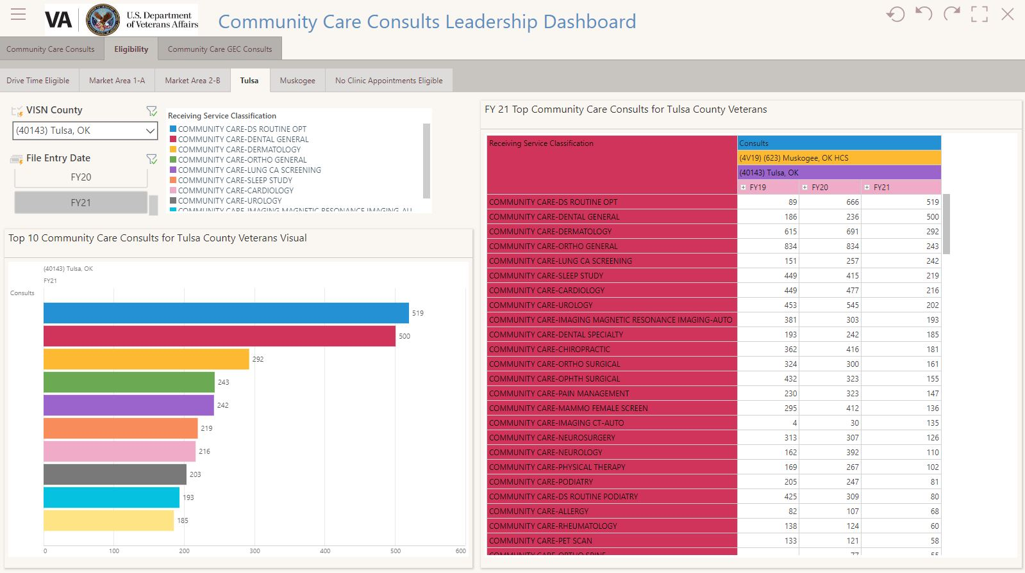
Notes:
This could also be helpful with planning the activation of new locations and tracking the impact of efforts to reduce community care refferrals. One example for our facility is the community care dental consults in Tulsa, which have more than doubled in the first two quarters this year compared to the total number of dental consults last year. Due to the upcoming activation of our new health care center the existing dental clinic with 12 chairs was planned to be closed and the services expanded within the new health care center. Leadership requested and was approved to continue operations at both locations expanding the service from an additional 3 chairs to 15 chairs.

Slide 6
Monitor Impact
Activation of new health care center
Activation of new Community Based Outpatient Clinic
On-boarding of providers
Expansion of services
Creation of new services
Notes:
Although the dashboard is intended to provide an overview of referral patterns, the dashboard can be utilized to monitor the impacts of changes such as activating a new health care center in July, activating a new community-based outpatient clinic in the fall, the hiring of specialty care providers, expansion of existing services and additions of new services. One recent example is the on boarding of a new dermatologist in January, which contributed to a 33.3% reduction in dermatology consults referred to the community in February.

