Slide 1
Problem Statement
Comprehensive Flow of Bed Management
Thomas Wan, MBA-HCA
GHATP Trainee, VISN 21
Data inaccuracy within the bed management system contribute to unnecessary bed flow/turnaround delays.
Notes:
Hello, my name is Tommy Wan and I’m the GHATP Trainee for the VISN 21 Network Office.
My project focuses on the flow of bed management for inpatient services.
I worked alongside the VISN Nurse Executive/Quality Management Officer and closely with the San Francisco VA Medical Center team.
The problem statement for the project is “Data inaccuracy within the bed management system contribute to unnecessary bed flow & turnaround delays”.

Slide 2
Reduce patient wait time
Improve bed turnaround time
Preparation for COVID capacity
Financial savings
Goals & objectives
Notes:
The Goals and objectives for our team.
•Reducing Patient wait time
•Improving Bed turnaround time
•Preparation for COVID capacity
•And Financials Savings

Slide 3
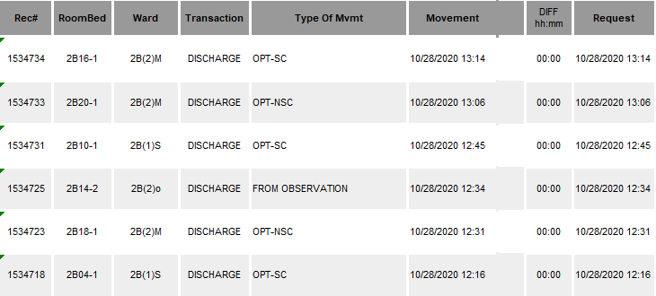
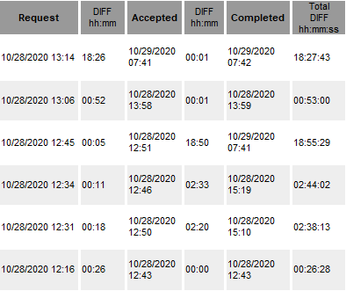
Background
Discharge
Acceptance/Cleaning
Notes:
Following review of the Bed Turnaround reports, real time data was not properly captured from patient discharge times, acceptance of bed cleanings, and the documentation of clean beds.
For example, we recognized patterns of batching as seen here in the time differences from submissions.

Slide 4
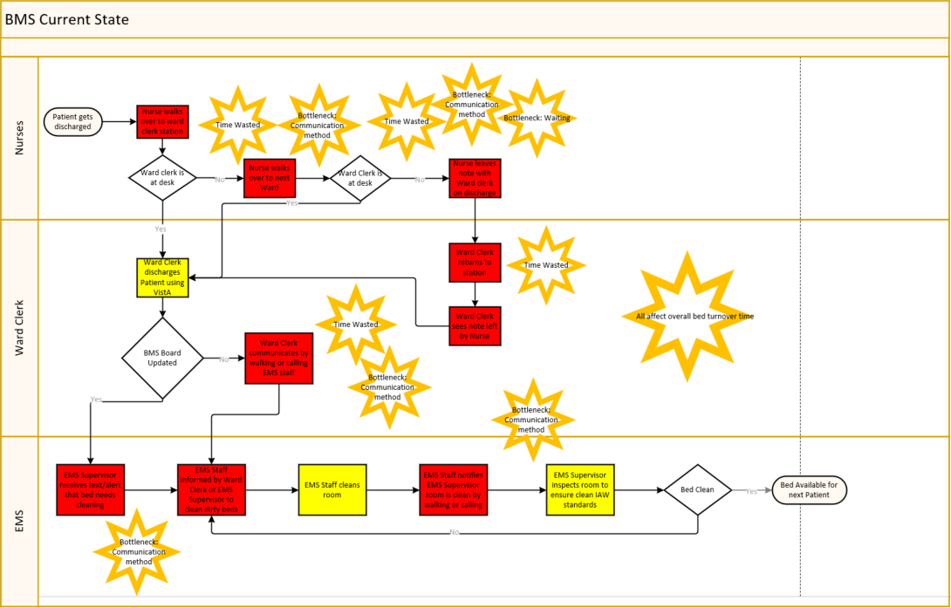
Current State
Notes:
In the report, the roles associated with the process included the nursing staff, ward clerks, and housekeeping services.
Our current state displays swim lanes from each respective roles in the bed management process.
The current state identified many bottlenecks in communication methods resulting in wasted time.

Slide 5
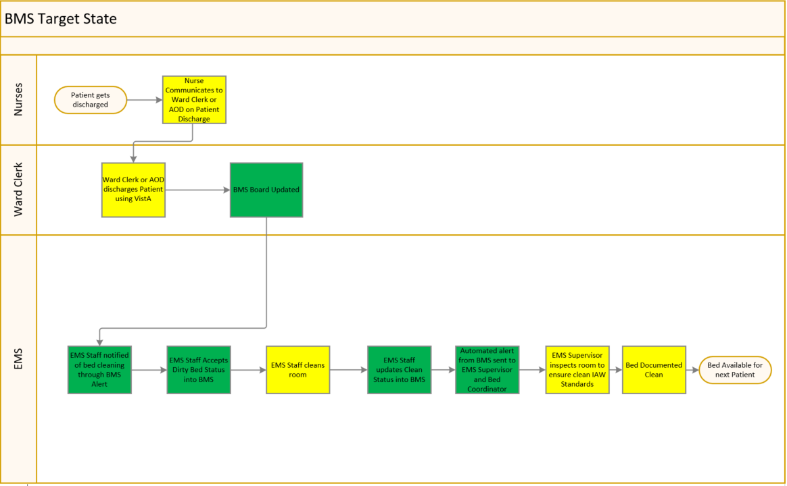
Planning & Development
Gemba
Analyze Current/Target state
LEAN approach
Education/Training
Collaboration
Notes:
Our first step in the Planning and Development stage was conducting a GEMBA.
The GEMBA was vital in understanding the background of information we received from the reports. It also helped develop our current and target state.
We decided to use the LEAN approach to dissect identified issues for process improvement starting with Med Surg Ward 2B.
Educating, training, and collaborating with the services associated were key to developing a target state that suggestively reduced the bottlenecks within the process.

Slide 6
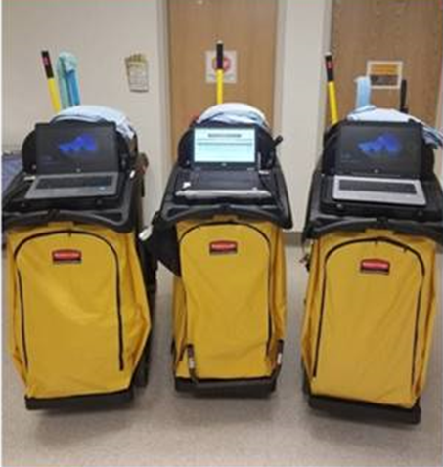
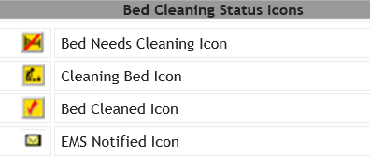
Implementation
Educate/Train Nurses, Ward Clerks, Housekeeping
Icon/Functions in BMS
Mobile Laptops for housekeeping
Communications method
Notes:
In the Implementation Phase, Educating and Training the nurses, ward clerks, and housekeeping staff on the functionalities of the BMS system was imperative.
Furthermore, our team had to ensure that icons and functions matched the facilities flow in communicating the patient status for accurate data capture.
We also implemented a rapid experiment of mobile laptops with the housekeeping staff for real time data input.

Slide 7
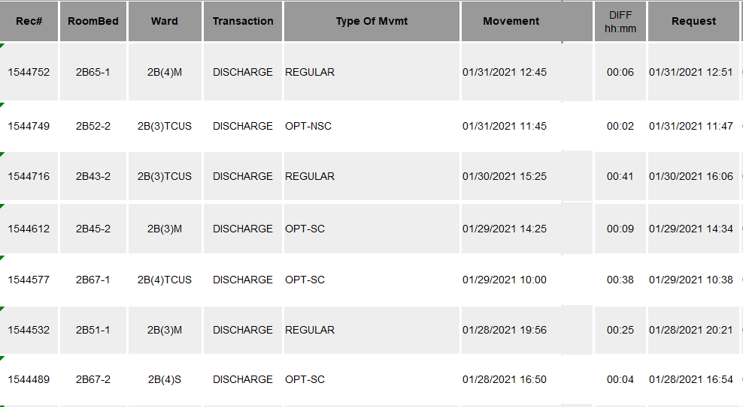
Expected Outcomes
Real Time Data
Process Improvement
Communication
Flow
Cost Savings
Data reliability
LEAN
Nursing; Ward Clerks; Housekeeping
Service to service
Bed Days Cost
Success
Baseline State Data | December 2020 | January 2021 | Feb 2021
Avg. 5 hours | Avg 3hrs 24 min | Avg. 3hrs 16 min | Avg. 2hrs 28min
Amount
5hrs – 3hrs 02min= 1hr 58min difference x $188.50/hr = $371.35 avg saved per bed days cost within 3 months Time & Costs Saved from Baseline Dec 2020: 1hr 36min x 188.50/hr = $301.60 Jan 2021: 1hr 44min x 188.50/hr = $326.91 Feb 2021: 2hr 32min x 188.50/hr = $476.91
Notes:
Our Project is ongoing as we monitor data for continuous process improvement
We’re seeing real time data being accurately captured in the bed management system
Time differences recorded show a significant change compared to the past 3 months; As highlighted, decrease in batching of discharges.
This resulted in successfully reducing our overall bed turnaround time starting at a baseline avg of 5 hours down to an avg of 3hrs and 2 minutes. We successfully reduced the bed turnaround time by an avg of 1hr and 58 minutes; saving approximately $371 per bed days cost.
We hope to continue improving our processes to effectively reduce patient wait times and inpatient costs.
This concludes my presentation. Thank you.

