Slide 1
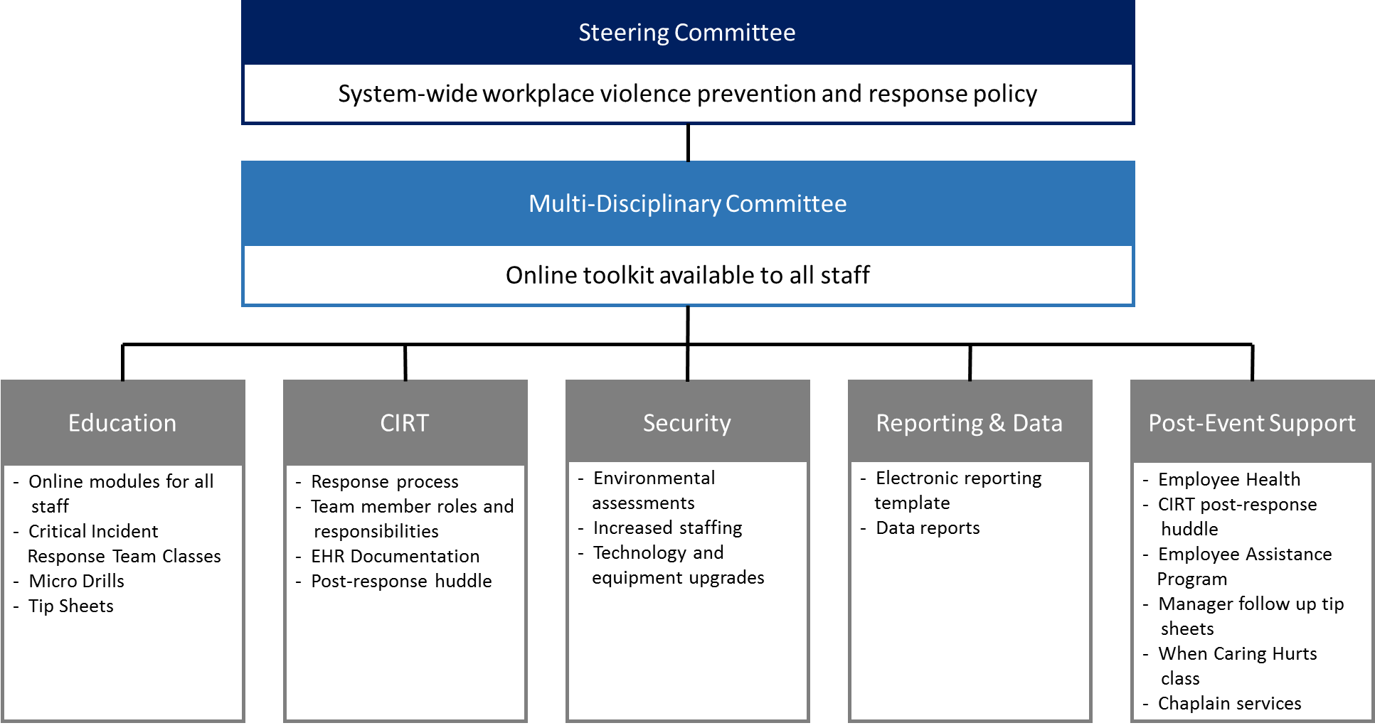
Project Safe Workplace: A Healthcare System’s Approach to Workplace Violence Prevention
Catherine Barrett, MHSA, Operations Project Consultant and Kristen Vogrin, BSN, RN, CPHQ, CPPS
BACKGROUND
Healthcare workers are 4 times more likely to be affected by workplace violence than any other industry in the United States.
In 2017 the rate of injuries due to workplace
violence that resulted in days away from work for
healthcare employees was 8.0 per 10,000 work,
compared to 1.9 per 10,000 workers in the private
sector.
The American Hospital Association estimated costs
to employers at $2.7 billion in 2016 secondary to
workplace violence incidents.
Addressing behavioral issues in the non-behavioral
setting is a challenge that can result in unsafe,
disruptive, or violent conduct.
Many employees did not know how to respond and what to do during a workplace violence event.
Workplace violence events were underreported.
METHODS
RESULTS
Saint Luke’s Health System employees have a toolkit and the resources to keep their workplace safe from violence.
Workplace violence reporting increased 56%.
473 employees have completed the Crisis and De-escalation class, a Critical Incident Response Team requirement.
9,354 employees completed the Level 4 Healthy Work Environment online modules. (These classes included conflict resolution, aggression recognition, and intervention, the crisis cycle, and empathy.)
11, 123 employees completed the Level 3 Healthy Work Environment online modules. (These classes included crisis intervention basics, bullying, lateral violence, and prevention and communication skills.)
Frontline staff feedback is positive and included: 1) “It was nice not to be responsible for workplace violence incident reporting after I was involved in an incident,” 2) “The debriefing and post huddles have been very helpful,” and 3)
“I feel supported by my organization when a
workplace violence event occurs.”
The Project Safe Workplace project improvement (PI) process design was based on the W. Edwards Deming model, Plan-Do-Study-Act (PDSA). Five workgroups were assigned tasks to complete and deliver to the multidisciplinary committee with all work utilizing the PDSA model. A one year time period was given to complete the Project Safe Workplace toolkit. The setting was a healthcare system that spans: academic and community hospitals, convenient care clinics, primary care clinics, urgent care, home care and hospice, rehabilitation institute, primary care, and multiple specialty clinics. The finalized toolkit follows a modified PDSA model allowing for continuous monitoring and process improvement going forward.
Educate
Respond
Support
Report
Analyze
Prevent
PURPOSE
The purpose of the project is to create a standardized process for:
Reporting workplace violence events.
Intervention process when a workplace violence event occurs.
Workplace violence prevention education.
Providing workplace safety during a workplace violence event.
REFERENCES
Gillam S. W. Nonviolent crisis intervention training and the incidence of violent events in a large hospital emergency department: an observational quality improvement study. Adv Emerg Nurs J. 2014 Apr-Jun; 36(2):177-88.
Occupational Safety and Health Administration, Guidelines for Preventing Workplace Violence for Healthcare and Social Service Workers, U.S. Department of Labor, 2016. https://www.osha.gov/Publications/osha3148.pdf (accessed June 15, 2018).
Phillips, J. P. (2016). Workplace Violence against Health Care Workers in the United States. New England Journal of Medicine, 374(17), 1661-1669. doi:10.1056/nejmra1501998
Sakallaris, B. R., MacAllister, L., Voss, M., Smith, K., & Jonas, W. B. (2015, May 4). Optimal Healing Environments. Global Advances in Health and Medicine, (4), 40-45. http://dx.doi.org/10.7453/gahmj.2015.043
Van Den Bos, ASA, MAAA, J., Creten, FSA, MAAA, N., Davenport, S., & Roberts, MBA, M. (2017, July 26). Cost of community violence to hospitals and health systems (Rep.). Retrieved August 03, 2018, from Milliman website: http://www.aha.org/content/17/community-violence-report.pdf
Whitman, E. (2017). Quelling a Storm of Violence. Modern Healthcare, 47(11), 18-21.
“Workplace Violence Prevention and Intervention”, ASIS/SHRM WVPI.1-2011. American National Standard
CONCLUSIONS
Caring for behavioral patients in the non-behavioral setting can be difficult without the right tools. The prevention of violence in the healthcare setting has proven to reduce costs, decrease negative patient outcomes, and reduce the negative consequences of the events on the caregivers, their families, and the community. The valuable insights of clinical, non-clinical, and leadership paved the way to build a toolkit with actionable steps to follow, no matter the healthcare setting. The Saint Luke’s Health System Project Safe Toolkit process improvement project demonstrated the right tools can be put in place with a collaborative multidisciplinary approach to improving worker’s safety.

