Slide 1
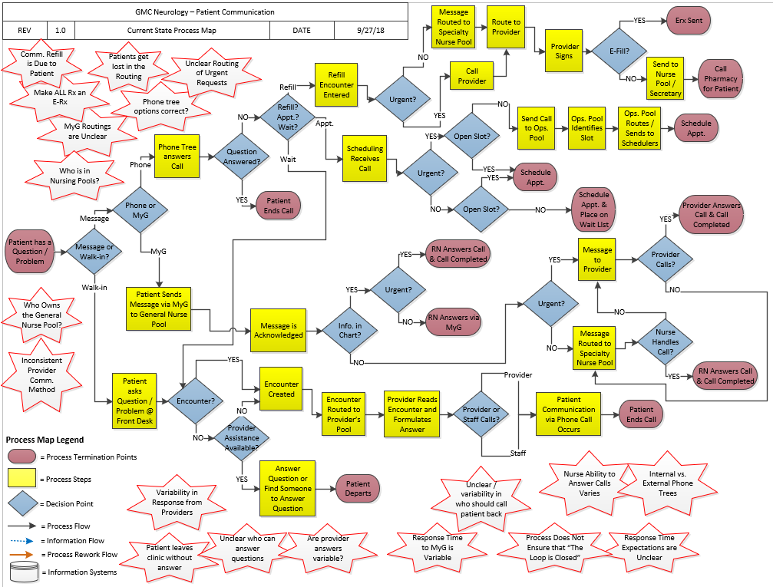
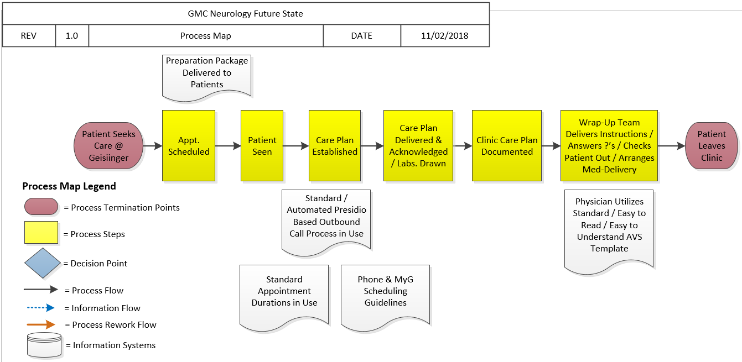
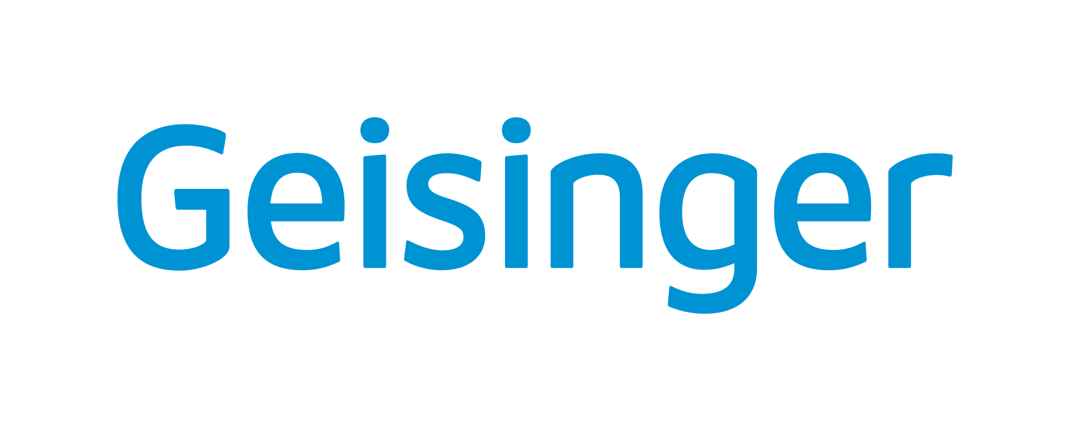
Optimizing Patient Communication Channels in Neuroscience Clinics
Ed Stefanowicz, MBA, Erick Lewis, MBA, Scott Friedenberg, MD, Sara Cole, Kristal Passmore
Geisinger Medical Center, Danville, PA
Introduction
What is Lean?
Research Methods and Metrics
The Geisinger Neuroscience Institute’s Neurology and Neurosurgery service lines formed Lean teams to examine patient communication across several hospital campuses. It was discovered that many routes of communication to and from patients exist and opportunities were identified in each communication modality. These included inbound phone calls, e-mails using EPIC MyChart (the patient messaging function in our electronic health record), and in-person communication during office visits (including office visit notes, wrap up, next steps, and the check-out process). Office visit wrap-up and information disclosure during check-out lacked sufficient care recommendations and clarity for patients.
Deeper investigation identified outdated phone trees, poorly mapped patient email flow and a disorganized system for determining which staff member was responsible for the patient’s communication. This created delays in care completion or incomplete patient care, additional work for our staff, and produced low Press Ganey¹ scores and incohesive staff performance.
Lean is a continuous improvement methodology and culture that strives to remove waste in order to maximize value for our customers. In healthcare our customers are our patients, patient’s families, insurers, the community and each other. By removing waste, we can provide higher quality, patient centered care, at a lower cost².
Current state research (Figure 1) showed that the process of handling incoming patient communication evolved over time to become inefficient and too complicated. The process included too many decision points and lacked streamlined standard work.
Several metrics were closely monitored and baseline data was recorded. Key performance indicators included Press Ganey scores, (Overall and Ease of Getting Clinic on Phone (which was later changed on the survey to Ease of Contacting)), phone call volume, volume of abandoned calls, and maximum call wait time.
Future state (Figure 2) was designed in a way that would rely on standard work to provide structure for prompt response to patient communication needs during the entirety of their care. This included a new phone system, redesigned patient email system, support staff education and redeployment, enhanced after visit summaries that allowed for customized patient education, instructions on when and how to contact the clinic.
Why Use Lean in Healthcare?
Lean process improvement and management principles were originally used in manufacturing and transitioned into the healthcare industry in early 2000's. Although healthcare differs in many ways from manufacturing, there are also similarities. Both enterprises rely on complex processes to accomplish tasks and provide value as defined by the patient or customer. Waste of money, time, supplies or effort decreases value. With healthcare costs rising, and reimbursement declining, there are many opportunities for improvement in all of our work.
Table 1 – Press Ganey Scores – baseline, implementation and most recent quarter (2019 Q4)
Objective
Results
To provide patients with timely and reliable answers to questions on their first request via phone, or patient e-mail, by pre-emptively answering their questions and providing a reliable, streamlined system for resolving their questions.
New communication process resulting in the following metric improvements:
Improved Overall Press Ganey score by 2.1% (Table 1)
Increased our Ease of getting clinic on phone Press Ganey score by 9.3% (Table 1)
Reduced our total call volume by 11% (Table 2)
Reduced our abandoned calls by 81% (Table 2)
Reduced our phone wait time by 70% (Table 3)
A customizable after visit summary was deployed, with assistance from our EPIC team, which allowed providers to input patient specific instructions and displayed an improved / easier to read format.
The new phone system was implemented with an optimized phone tree design that allows staff to be assigned to specific roles (secretary, nurse, OR scheduler, etc.) that allow staff collaboration to ensure calls are answered.
Lastly, the routing of patient e-communication was streamlined so that it all flows immediately to the subspecialty program nurse who directly handles and triages patient needs. Previously, the messages flowed to general nurses who then routed them to the correct clinical programs. This resulted in unnecessary delay for the patient. Efficiency was also gained by deactivating 38 in-basket pools, renaming and merging existing ones, and retraining staff on the new program pool design.
Planning and Background
This project followed Geisinger’s Lean methodology, (A3 utilization with process details in each section.) The root cause was ineffective communication during office visits, leaving patients unsure of next steps or after-visit requirements. The phone system was inadequate at handling incoming call volume. This created long wait times for patients, high rate of abandoned calls, and an increase in patient e-mails as a result of not getting through on the phone. The problem was essentially twofold; lack of patient understanding prior to leaving clinic that resulted in them needing to contact the clinic, and a poorly designed incoming call system.
Prior to the lean project, clinic staff answering phones were overwhelmed and were requesting help in the form of additional staff members.
Investigation into the phone system yielded several opportunities; outdated phone tree options, varying phone trees based on if you called from inside the hospital or from an external number, inconsistency of phone numbers being given to patients, unnecessary options on the phone tree, option order not optimized by call volume, inefficient patient e-mail inbox design and answering flow.
Table 2 – Phone Volume – Total number of calls and number of abandoned calls; baseline, implementation and most recent quarter (2019 Q4)
Figure 1 – Current State Process Map – Incoming patient call, message, or walk-in
Conclusion
Table 3 - Average caller wait time (min) – baseline, implementation and most recent quarter (2019 Q4). Baseline 2018 Q4 vs. current state shows that a 76% improvement has been sustained.
The redesign of patient communication for Neurology and Neurosurgery, which was guided and reinforced by the Geisinger lean process, successfully improved our patient communication by reducing the need for patients to call, improving our ability to handle the volume of calls answered and improving the speed with which these inquiries were answered. This resulted in an improvement of our patient reported satisfaction. Extensive change management was required across several campuses and staff types to implement and sustain the change. Ongoing performance is monitored by our daily management system.
References
Figure 2 – Future State Process Map – Incoming patient call, message, or walk-in
Press Ganey (2020, March 19). Committed to improving safety, quality, and patient-centered care. Retrieved from https://www.pressganey.com/
Geisinger (2020, March 2). Lean at Geisinger. Retrieved from https://geisinger.sharepoint.com/sites/Lean/SitePages/Problem-Solving-Course.aspx

