Slide 1
Caring For Our Communities: A Blueprint for Better Outcomes in Population Health
A Case-based TOOL to advance population health in your community
Mark Angelo, MD, MHA, FACP

Slide 2
About this toolkit:
Thank you for purchasing this toolkit to accompany Caring for Our Communities: A Blueprint for Better Population Health Outcomes by Dr. Mark Angelo.
The purpose of the toolkit is to demonstrate real-world scenarios encountered when initiating and advancing a population health initiative. Through this learning program, we hope to spark additional thoughts as we solidify your knowledge and give some additional tactics surrounding population health strategies.
This toolkit represents a hybridization of multiple encounters across the nation; some situations may have been modified to protect privacy as well as to create a demonstrative learning opportunity. Not all tactics will work in all situations.

Slide 3
Starting from scratch: Jones Health Center (JHC)
JHC is a not-for-profit (NFP) integrated delivery system (IDS) with 4 hospitals, 2 surgery centers, and 14 ambulatory care sites.
The health system has felt some financial strain post-pandemic with the rising need for contract labor and supply costs that are now 15–20% higher than before the pandemic.
The payers in the region of JHC have been stagnant in their reimbursement for procedures and office visits. The payers have suggested JHC create a value-based structure if they wish to increase their reimbursement.
JHC leaders have raised concerns that this type of infrastructure will be costly and have a negative financial return, yet they are willing to explore this new paradigm.
As the newly designated champion for population health, how do you approach their emerging need for managing populations?
How would you understand the potential for success in value-based agreements being offered to your health system?
What would you foresee as “short-term wins” to boost your newly formed initiative to lead the organization on a successful path in population health?

Slide 4
WHERE DO I START?
CONCEPTUAL CONSIDERATIONS
Define your population? Options include
payer attribution (i.e., Medicare, Medicaid, commercial payer, etc.),
patients who see your PCPs, and
all patients who see any provider in your IDN.
What data is being collected about your attributed patients? What is the source of your data?
What is your historical performance on quality and cost? Is there opportunity to improve?
Can you recreate external performance data through your EMR and internal analytic capabilities?
Has your NFP system completed a Community Health Needs Assessment?*
*The IRS mandates that NFP hospital organizations conduct needs assessment every three years and adopt a strategy for meeting the needs of their communities.

Slide 5
KEEP PATIENTS IN THE CENTER OF CARE DECISIONS
Do your attributed patients have adequate access to care? Are your providers available to your population?
Can patients schedule appointments and travel to visits in a timely manner?
What is the societal and community context? Are there structural impediments to care delivery?
Does the population struggle with financial aspects of care? Are adequate resources available for patients in need?
What is the health and technology literacy of your population? Can individuals schedule and complete telehealth visits?
Do patients have to use emergency services in excess due to challenges in transportation, economics, or health literacy?

Slide 6
Getting the ball rolling: Jones Health Center (JHC)
JHC senior leaders have agreed to move forward with a population health strategy given their understanding of the growing needs in the market and their desire to be better positioned for the future realities of care delivery.
As the director of population health, you are now given the opportunity to review payer programs, including the Medicare Shared Savings Program (MSSP), Managed Medicaid, and Medicare Advantage.
You determine that the focus of your programs will be the large, employed JHC medical practice as well as affiliated providers within the network.

Slide 7
What do I have? What do I need?
Care coordination – Often delivered by nurses but can be augmented by pharmacists, advanced practice providers, and other team members.
Technology – Allows your population health team to receive non-standardized reports from payers; connects to the electronic medical record and the health information exchange to support reporting in a way that is meaningful to providers.
Physician and network leadership – Strong and insightful provider leadership will advocate for the new model of care and educate other providers.
Continuum of care – Supports patients across all areas of care from the home, to acute care, to rehabilitation facilities.
Quality infrastructure – Works to create a tailored set of HEDIS,* Stars, or other measures that are prevalent across all programs and that oversee performance.
*Health Effectiveness Data and Information Set

Slide 8
What are the responsibilities of the practices?

Slide 9
Consider the sources of data for your population.
Is your data accurate and comprehensive?
Do you have infrastructure to process the data matched to patients correctly and without duplication?
Can you utilize the data to create meaningful and actionable insights to improve population health?

Slide 10
WHO WILL BENEFIT FROM CARE COORDINATION?
High-risk, high utilizers will have significant needs, such as home-based services, behavioral health, palliative care, or chronic care management.
Rising-risk population may represent impactable opportunity before they fall into high utilization patterns.
Inappropriate utilization requires further evaluation. Possible problems include the following:
Access to care
Health literacy
Social drivers of health
Accurate documentation and risk coding is important for all programs.
Low-risk individuals may need automated outreach for maintaining annual contact to facilitate closing preventative care and quality gaps.

Slide 12
Understanding payer programs: Jones Health Center (JHC)
In researching your MSSP opportunities, you find multiple risk tracks that range from low risk and low reward to higher risk and higher reward.
Some payer programs offer quality incentives alone and others offer shared savings if costs are reduced below a benchmark.
Should your organization prepare for a two-sided risk program?
How will you know how your population performs compared to a percentage of premium performance threshold?
Does historical performance give satisfactory information about future success?

Slide 14
Setting up long-term success: Jones Health Center (JHC)
With the counsel of the JHC leadership team, you determine that the best path forward involves initiating a single-sided risk program to begin.
Careful negotiations with area payers yield a program where JHC can receive a quality incentive payment and an incentive for decreasing the cost of care for an initial period.
With some reallocation of resources for care coordinators, informaticists, and data analysts, your population health efforts are underway.
How do you build a sustainable, high-performing system that will offer meaningful impact on the health of your community and produce a positive return on investment (ROI)?

Slide 15
Considerations for success
Navigating the health system is difficult for patients, and care management is essential for better outcomes.
Successful population health platforms engage a primary care–centered model.
Focus on medication adherence and management of individuals with high disease and/or medication burden. Poor adherence is often a source of exacerbation of chronic illness.
Care retention within your network is important to allow for real-time oversight and management of those requiring acute care or specialist services.
Your informatics team can help you to make the right thing to do the easy thing to do for your providers at the point of care.
Different segments of the population require different modes of intervention. Individuals with serious illness should be a population of focus.
Your population health team should lead the charge on gathering data on social drivers of health while forging pathways to mitigate those barriers.

Slide 16
Population Health focuses on equitability and transparency
Managing disparities in care and social factors that impact health outcomes is essential.
Many barriers to healthy outcomes exist along the continuum of care
Engagement with community-based resources (i.e., faith-based organizations, community centers, volunteer organizations) will help to understand more about the challenges within a population and connect individuals with solutions

Slide 17
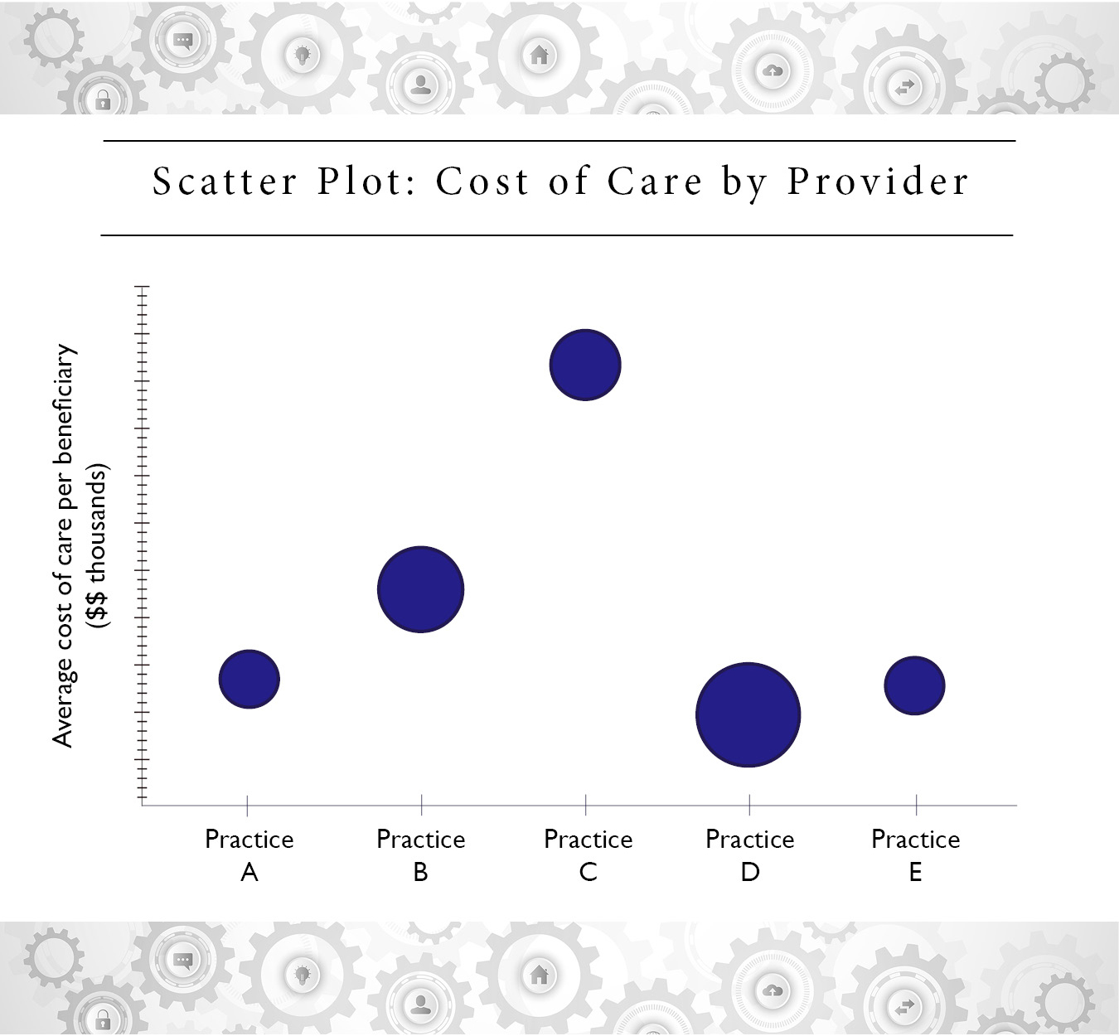
Population Health focuses on equitability and transparency
Now that you can produce meaningful analytics, data transparency is important across the network.
Here is an example of a data comparison that may be shared with your physicians within your network.
It is important to explore performance outliers to understand what drives their outcomes.

Slide 18
final Considerations for success
Your physicians and other providers are your partners in your population health efforts.
You should encourage, educate, and incentivize your physicians to drive behavior and outcomes necessary for population health.
Medical directors and their engagement are essential.
When in doubt, keep the population health quintuple aim in mind.

